Slide 1
NC LIVE:
Libraries taking a TEAM approach
NC SeAL & Open Library NC
NCCCLRA Conference
Asheville, North Carolina
April 2, 2012
Jill Morris, Assistant Director
Heather Greer Klein, Online Services Librarian

Slide 2
Overview
NC LIVE Updates
Building Shared Collections
  NC SeAL – Shared eAudio Library
Open Library NC

Slide 3
NC LIVE Updates

Slide 4

Changes to NC LIVE Advisory Committee Structure
  Proposed changes to meet the organization’s evolving needs. Your feedback is needed!
  Increase Committee Size to 12
  Introduce the concept of membership terms – though no term limits.
  Revise committee names and add a new committee: Metadata Advisory Committee
Read proposed changes and provide feedback:
http://nclive.org/committee-feedback
Notes:
Committee Changes – Feedback needed
As NC LIVE’s needs have changed, so has its need for advisory committees. Committees play a role, much like an internal focus group, to help staff collect feedback and make decisions that are good for member libraries.
Proposed changes include:
Increase committee size: from 8 to 12 members. Increasing the size of the committees will provide for better coverage of the overall membership while also increasing the likelihood that there is more representative diversity within each COI. Committee members will continue to be selected by the COIs in whatever manner the COI chooses. A job description for the members of each committee will be created to ensure that all necessary skills and talents are represented.
Set terms for members. Each committee member will serve for a term of three years, after which his/her COI will determine (using whatever method they wish) whether the term will be renewed. NC LIVE will not have term limits in place, but neither will it restrict a COI from setting term limits for its committee representatives. Current members will be assigned a term of 1 or 2 years.
Chair Selection. All chairs will be selected by the Librarians Council and will serve a term of one year, renewable two additional times. Not all COIs need to have a committee assignment, but the LC will make an attempt to have diversity in its chairs.
Meetings. Each committee will meet four times per year. Additional meetings as needed by the chair, the executive director, or the NC LIVE staff. While virtual meetings are often easier to schedule, at least two meeting will be held face to face to enable members to better get to know one another.
Voting by COI and consensus. Voting methods used by the Librarians Council will be extended to the committees. This means that each COI will have the equivalent of one vote, so regardless of how many representatives attend a meeting, each COI will be equally represented in votes. In addition, all committee business will require 100% agreement between COIs (i.e., consensus). Should a vote end in anything but 100% agreement, the decision will not stand and the action will not be taken.
Staff Liaison Librarians. Each committee will have a NC LIVE staff liaison librarian assigned to assist the chair and members with the work of the committee. The liaison librarian will staff the committee, prepare documents for consideration and review, provide project and initiative plans, drafting agendas and minutes, surveys, and meeting priorities, and generally preparing the chair and the committee to best communicate their individual and organizational needs.
Adding a Metadata Advisory Committee, changing the TAC -> Digital Services Advisory Committee, PAC -> Outreach, Promotions and Partnership, and keeping the WAC and RAC.
We need your feedback! http://nclive.org/committee-feedback

Slide 5
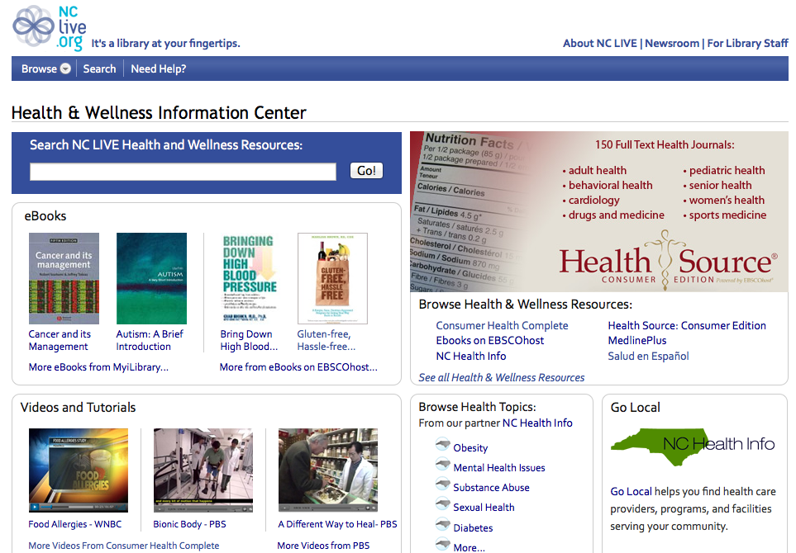
Health Information Portal
Health Portal – http://health.nclive.org
Notes:
Health Portal
The portal takes the place of the existing "Health & Wellness" category page that was simply an alphabetical listing of consumer health-related resources and databases.
Developed by NC LIVE staff in partnership with NC Health Info. A way for NC LIVE to feature all of its consumer health content in one place – eBooks, videos, magazines/journals & more!
You can link to it at Health.nclive.org
The Health & Wellness Portal is designed for members of the general public who are looking to find trustworthy health information online. The health portal includes free access to health information, news, journal articles, eBooks, videos, health resources in Spanish, and more.
The portal allows North Carolina residents to freely and easily search premium content from top health and medical journals and books. Additionally, trustworthy web resources have been hand-selected by health science librarians at The University of North Carolina at Chapel Hill. New content includes an information resources page for health content written in Spanish.
Other featured content includes free access to health related eBooks available from EBSCOhost and MyiLibrary. Hundreds of eBook titles are available on a variety of health topics including diet, fitness, and illnesses.
The Health and Wellness Portal also includes access to popular health videos from PBS, including Bionic Body and A Different Way to Heal. North Carolina libraries recently added more videos from the Patient Education Institute which are available through the NC Health Info health pages.
The portal was researched and designed by Amanda Foster, an NC LIVE field experience graduate student from UNC Chapel Hill's School of Information & Library Science, and in partnership with Christie Silbajoris at NC Health Info.

Slide 6





NC LIVE Updates:
Free Promotional Tools & Downloads
http://nclive.org/librarystaff/promote
Notes:
Free Promotional Tools & Downloads
From the Library Staff section of our website, you can find a variety of downloadable free tools, including logos, customizable posters and other materials..

Slide 7

NC LIVE Updates:
Authentication Fundamentals Project –
  Rebuilding NC LIVE’s authentication system to improve access to eResources.
Authentication Methods:
Password
EasyON (Library Card #)
Proxy Server
IP
Shibboleth
Geolocation

Slide 8

Recorded Books Update
Audio Books Now Available for Mac
  Recorded Books OneClick Media Manager is now downloadable from the App Store.
  iPhone & iPad Apps are coming soon!
  Interface updates and browsing functionality enhancements coming soon.

Slide 9

NC LIVE
NC Libraries Working as a Team:
Building Shared Collections

Slide 10
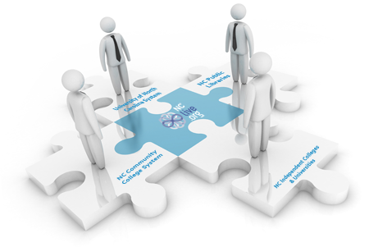
Purpose of NC LIVE
To help member libraries be more successful in supporting education, enhancing economic development, and increasing quality of life in North Carolina.
Organizational Values
Shared success, collaborative effort, and cooperation
Trust and respect across communities of libraries
Maximized use of resources
Free and equal access to library services

Slide 11
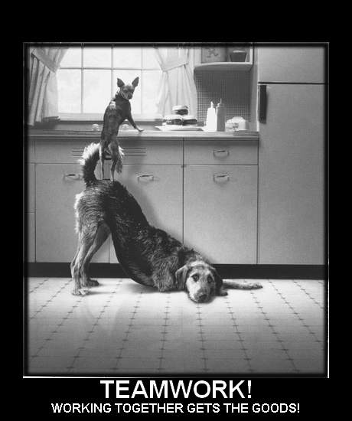
Building Shared Collections
Coming together is a beginning.
Keeping together is progress.
Working together is success.
~Henry Ford
Notes:
Building Shared Collections
NC LIVE came together in 1998 for a very distinct purpose – to provide libraries across the state with equal access to a shared collection of core eResources.
And we’ve been doing it ever since: Over the past 14 years, we’ve kept together - Libraries have shared resources through NC LIVE, serving nearly the same purpose the whole time. Resources have come and gone, but we’re still together.
We think our current collaboration has just started to scratch the surface of the advantages we can harness by collaborating. We’re now looking at new models we can use to allow individual libraries to work together and achieve far greater success together than we could alone.

Slide 12
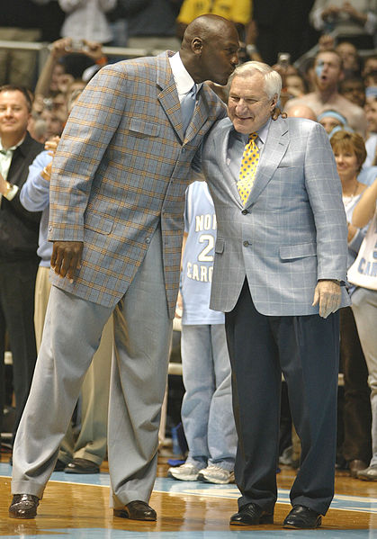
“Michael, if you can't pass, you can't play.”
~Dean Smith
(said to Michael Jordan in his freshman year at UNC)
The NC LIVE Team
198 Member Libraries
4 Communities of Interest
Many different unique talents, ideas, and resources that can be leveraged.
http://en.wikipedia.org/wiki/File:MichaelJordanDeanSmith.jpg

Slide 13
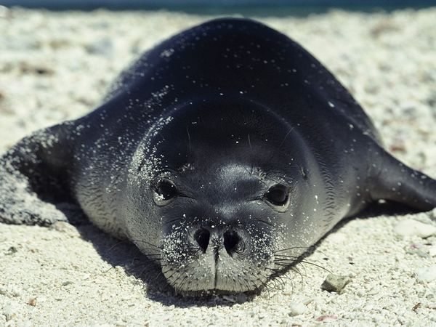
NC SeAL
North Carolina Shared eAudio Library
A platform to allow NC LIVE member libraries to build shared collections (of audio books), leveraging the resources of many different libraries for the collective good.
Add to the group, or individual collections, or BOTH!
http://animals.nationalgeographic.com/animals/mammals/hawaiian-monk-seal/
Notes:
NC SeAL – Acronym means NC Shared eAudio Library – but this is just an example, not limited to audio!
NC SeAL is really an example of the types of collaboration and teamwork that NC LIVE hopes to take greater advantage of going forward.
NC LIVE wants to harness its collective purchasing power to provide platforms that libraries can collectively build on and grow.

Slide 14







Ingram – MyiLibrary Audio
NC LIVE first experimented with this model using the Ingram MyiLibrary Audio Books platform.
NC LIVE purchased approximately 1,000 titles.
  Classic literature, non-fiction, language learning, history, and biography
About 20 NC LIVE member libraries added nearly 300 new titles, primarily popular content.

Slide 15
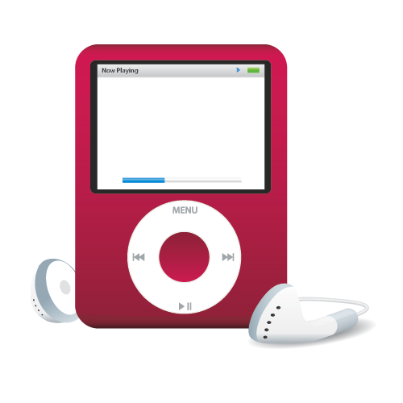
Participating Libraries
Wayne County Public Library (Goldsboro)
Mary Livermore Library (UNC Pembroke)
Burke County Public Library
Pitt Community College
Sheppard Memorial Library (Greenville)
Chapel Hill Public Library
Davie County Public Library
Cabarrus County Public Library
Randolph County Public Library
Gardner-Webb University
Granville County Library System
South Piedmont Community College
CPC Regional (New Bern)
New Hanover County Public Library
Notes:
14 libraries have added approximately 800 books to the collection for everyone across the state to use.

Slide 16
Recorded Books OneClick
NC LIVE is currently negotiating ways to allow member libraries to purchase and add to our shared collection of audio books.
NC LIVE is also investigating shared collections of other content types.
…Stay Tuned!

Slide 17
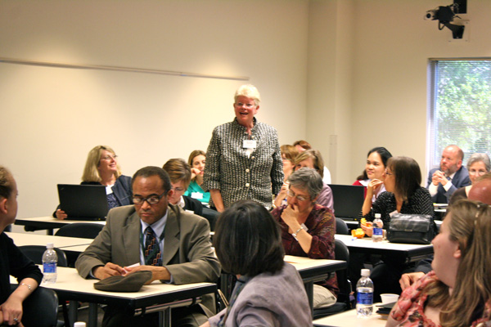
Permanent Resources Taskforce & Summit
The NC LIVE Resource Advisory Committee created a Permanent Resources Taskforce.
RAC members will select 8 people from each Community of Interest to participate in a Permanent Resources Summit on May 14th.
Notes:
Charge: To work with members of the NC LIVE Resources Advisory Committee (RAC) to
develop a multi-year plan for the purpose of building shared collections of non-
subscription digital content meant for permanent access/ownership.
Two members from each Community of Interest (COI). Selection of Taskforce
members will be determined by each COI. Members of the Resources Advisory
Committee may attend Taskforce meetings. In addition,
The Taskforce will present to the RAC a plan that:
1. Outlines the environmental factors influencing the needs for permanent
resources within and across COIs;
2. Describes logistical aspects of building shared collections via NC LIVE;
3. Identifies annual and multi-year goals and priorities;
4. Articulates budgetary estimates to achieve goals and priorities;
5. Describes expected usage patterns and targets and communicates methods for
assessing the sustainability of the plan and the collections;
6. Provides insight to the platforms and technologies needed by COIs and libraries
to ensure ongoing usage.

Slide 18
Permanent Resources Taskforce
The Taskforce will present a plan to the RAC that:
Outlines the environmental factors influencing the needs for permanent resources within and across COIs;
Describes logistical aspects of building shared collections via NC LIVE;
Identifies annual and multi-year goals and priorities;
Articulates budgetary estimates to achieve goals and priorities;
Describes expected usage patterns and targets and communicates methods for assessing the sustainability of the plan and the collections;
Provides insight to the platforms and technologies needed by COIs and libraries to ensure ongoing usage.

Slide 19
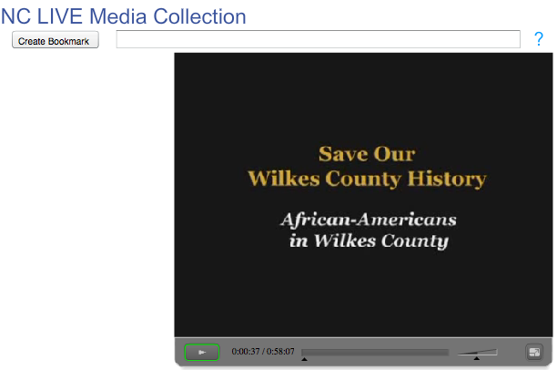
Wilkes County Historical Documentary Films
13 documentary films produced by Wilkes County. The films tell the story of Wilkes County through first-person recollections of community residents, as well as commentary from local historians.
NC LIVE hosts the digital video files on NC LIVE servers to allow access to the entire state.
http://media.nclive.org/browse_videos.phtml?Series=12

Slide 20
Getting Involved
If you are interested in participating and contributing to the shared eAudio collection, please contact Tim Rogers at tim@nclive.org.
Listserv Information
Participating libraries, as well as those interested in participating, can join the NC SeAL listserv.
http://mail.nclive.org/mailman/listinfo/ncseal-l
and enter your email address to subscribe.
Notes:
If you’re interested in finding out more about how you can participate in NC SeAL or other shared collection building opportunities, please contact tim@nclive.org.

Slide 21
Thank You!
Questions? Get in touch!
Email: jill@nclive.org or help@nclive.org
Phone: (919) 513-0451
http://facebook.com/NCLIVEOnlineLibrary
http://twitter.com/nclive
Subscribe to our news email list:
http://nclive.org/newsroom/listserv

