Slide 1
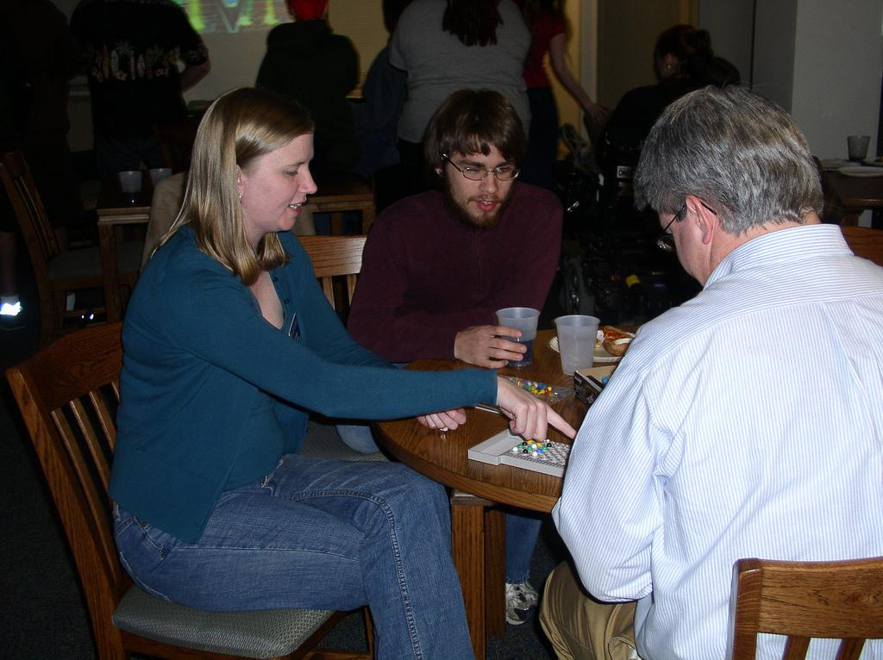
Get Your Game On: Student Outreach Through Gaming
Amy Harris Houk
UNCG
All images are available at http://www.flickr.com/photos/iminerva/

