Slide 1
Mobile Apps in Libraries: Past, Present & Future
Chad Haefele
Emerging Technologies Librarian, UNC Chapel Hill
cHaefele@email.unc.edu

Slide 2

The mobile app landscape

Slide 3
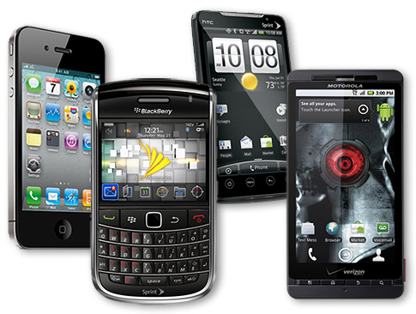
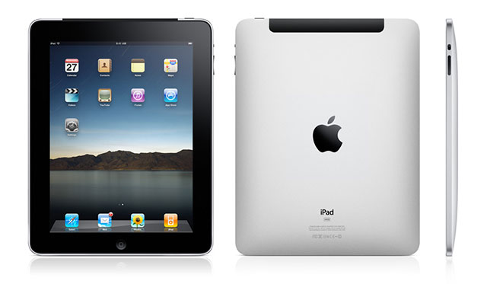
Mobile device:
a device you can use somewhere that you wouldn't use a laptop

Slide 4
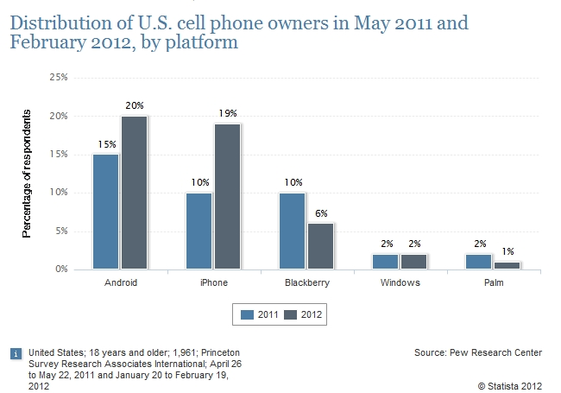
Past & Present – Who owns what?

Slide 5
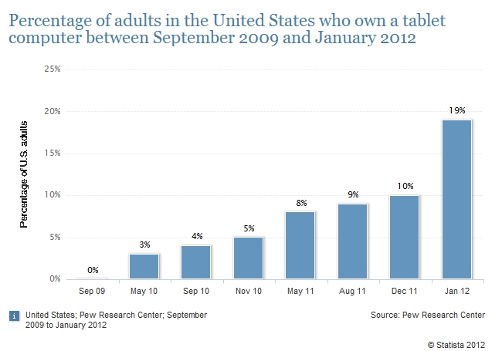
Past & Present – Who owns what?

Slide 6
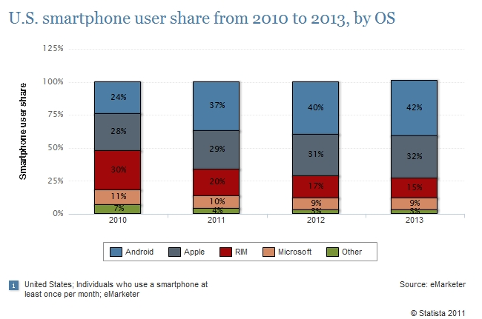
Past & Present – Who owns what?

Slide 7
What about here?
http://www.polleverywhere.com/multiple_choice_polls/NjM3NDQ2MzI3

Slide 8
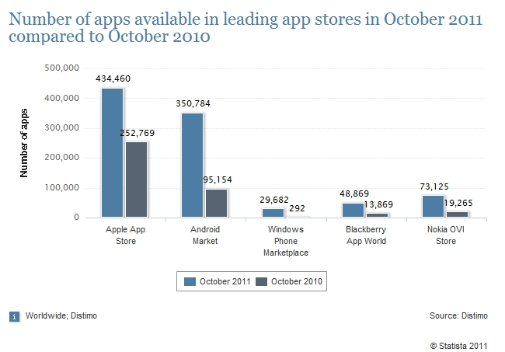
Number of apps

Slide 9
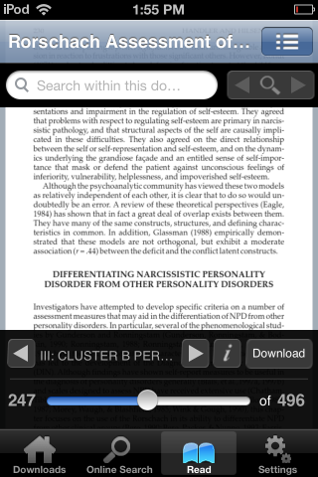
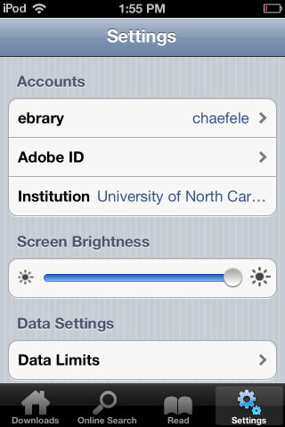
Mobile ebook reading: ebrary

Slide 10
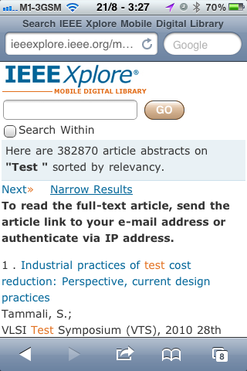
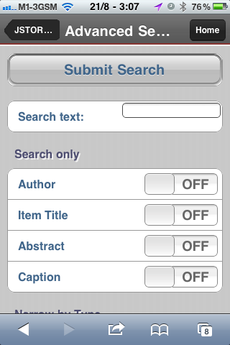
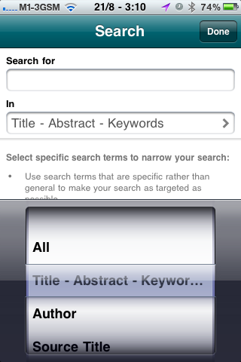
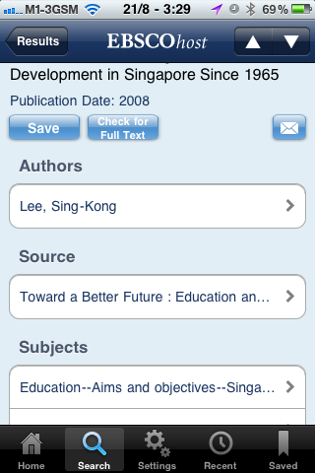
Mobile e-journal articles

Slide 11
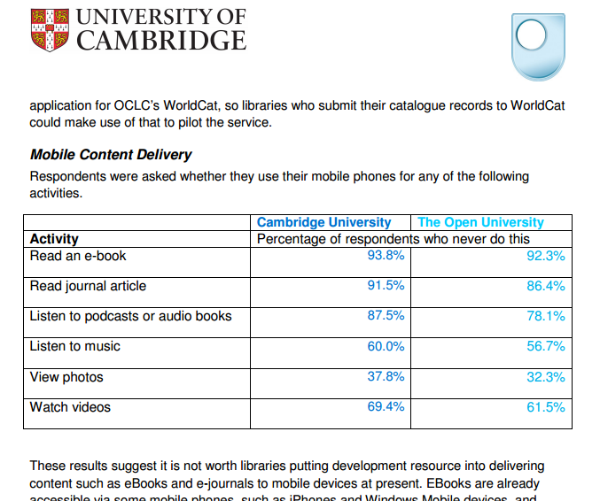
What services does it make sense to provide?

Slide 12
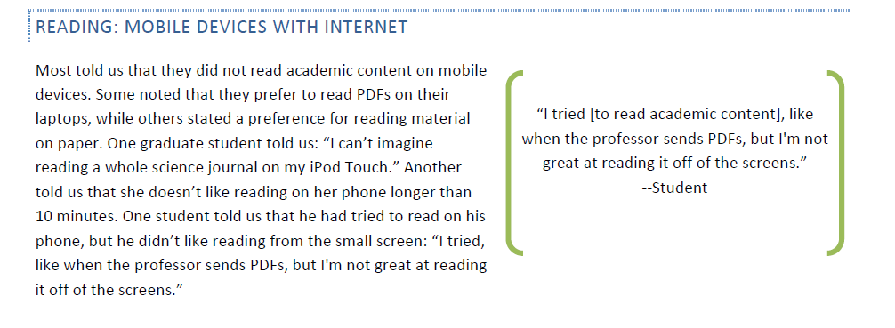
What services does it make sense to provide?
-California Digital Library’s Mobile Strategy Report

Slide 13
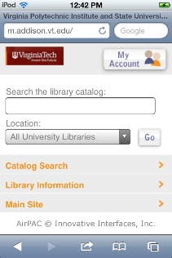
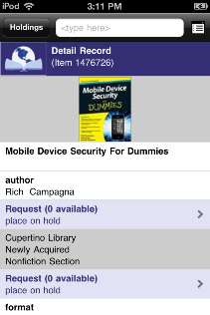
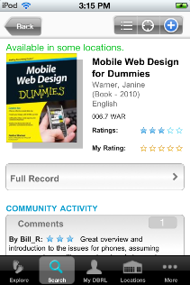
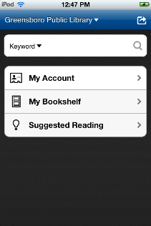
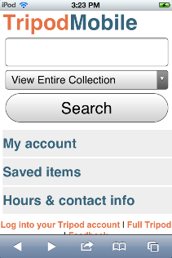

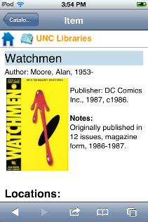
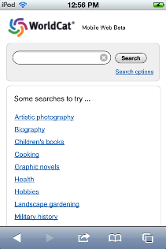
Mobile catalogs
Mobile Catalogs

Slide 14
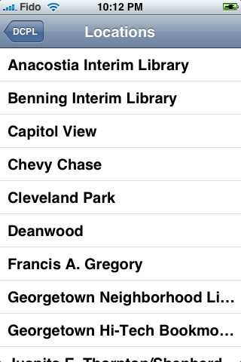
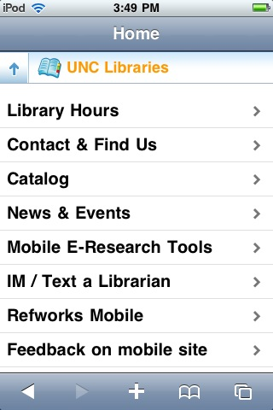
App vs Webapp

Slide 15
Platform: App or Webapp?
App
Webapp
Java, Objective C
Single platform
Full hardware access
(GPS, camera, etc)
Can be used offline
Tricky to get stats
HTML, CSS, Javascript
Multi-platform (maybe)
Limited hardware access (GPS only)
Requires web connection
Standard webstats

Slide 16
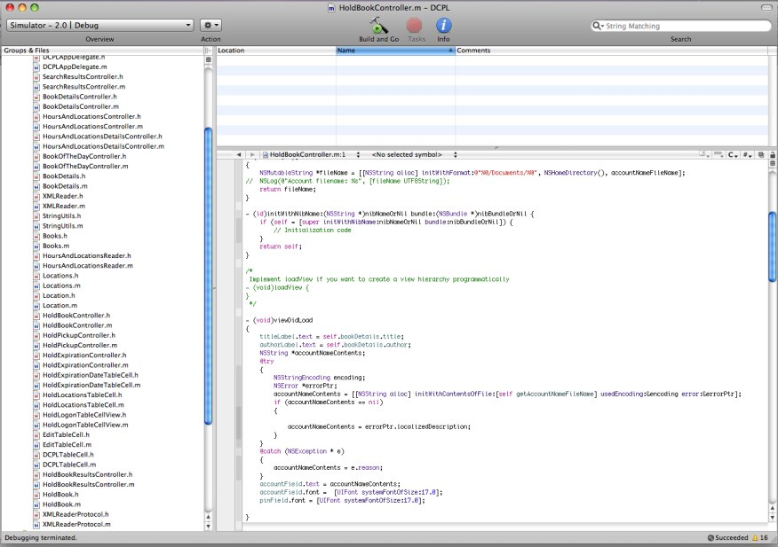
http://dclibrarylabs.org/
Coding an app
iPhone app code

Slide 17
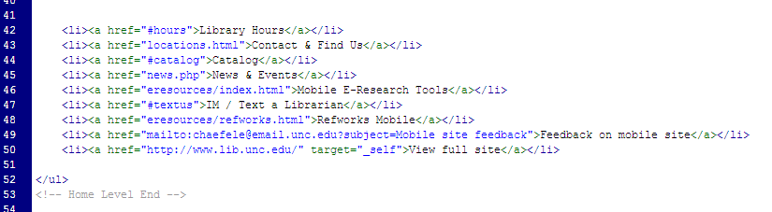
Webapp code
Coding a webapp
http://code.google.com/p/iui/

Slide 18
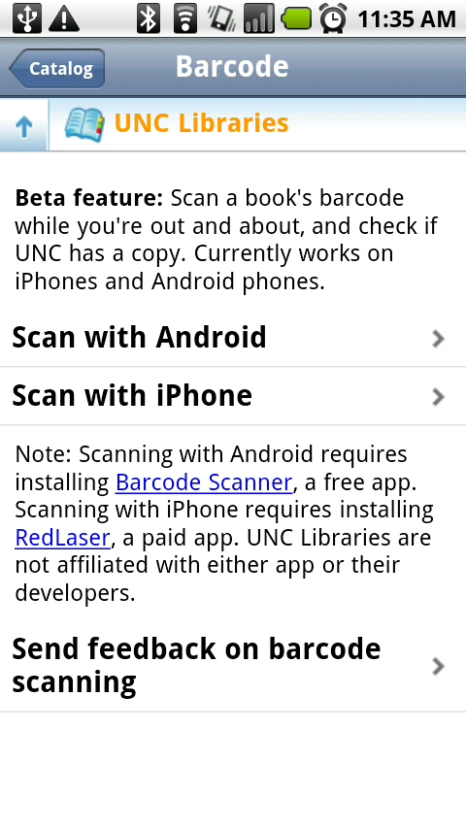


Webapps play well with others
Notes:
As I just said, webapp can’t access hardware. But it can play nicely with apps that can, in some cases.
Show video, barcode scanning example
Not perfect, requires explanation, streamlining in the future

Slide 19
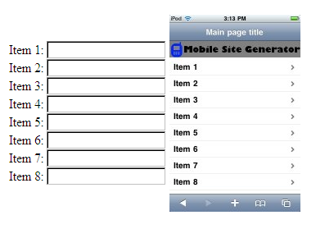
Mobile site generator
www.hiddenpeanuts.com/msg
Notes:
Looking closer

Slide 20
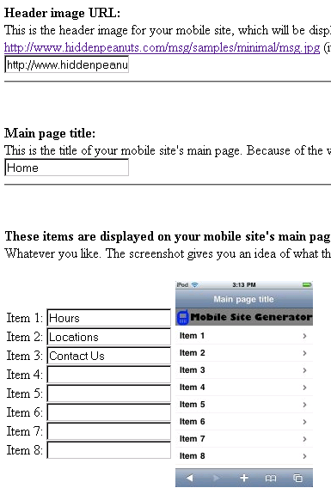
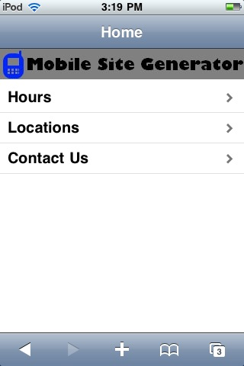

Slide 21

The Future…

Slide 22
App vs Webapp again
http://www.useit.com/alertbox/mobile-sites-apps.html
“Current Mobile Strategy: Apps Best”
“Future Mobile Strategy: Sites Best”
“The expense of mobile apps will increase because there will be more platforms to develop for. At a minimum, you'll have to support Android, iOS, and Windows Phone. Furthermore, many of these platforms will likely fork into multiple subplatforms that require different apps for a decent user experience.”

Slide 23
HTML5 & more on the horizon
Access to camera, GPS, mic, accelerometer, play video, etc
Youtube: m.youtube.com
Flickr: m.flickr.com
Google Reader: google.com/reader/i
Geolocation: foursquare.com
Notes:
Youtube’s frustrations w/ built-in iPhone app
Overall, greater interactivity
http://www.hiddenpeanuts.com/ala/demo2.php

Slide 24
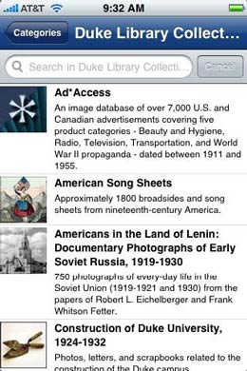
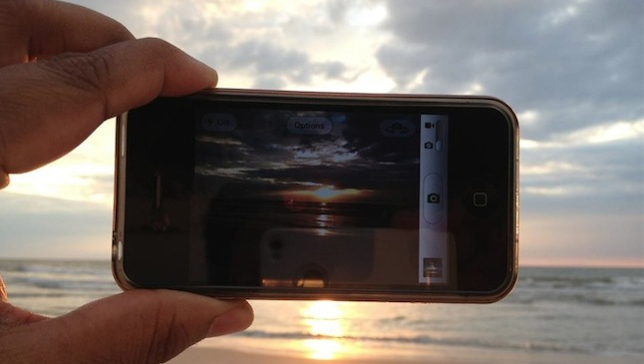
Can we turn things around?

Slide 25
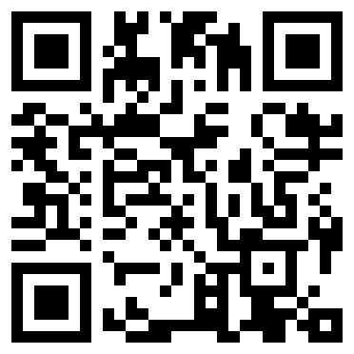
QR codes

Slide 26
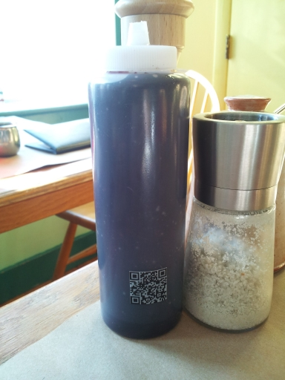

Slide 27
http://picturesofpeoplescanningqrcodes.tumblr.com/
Notes:
6.2% have scanned a qr code

Slide 28
Think crazier: AR shelf reading?
http://www.youtube.com/watch?v=NgZVI630SsI

Slide 29


Two development approaches:

Slide 30
Wanted: tech skills

Slide 31
Not for institutional use

Slide 32

cHaefele@email.unc.edu

