Slide 1
Beyond the Interview: how to stand out in the applicant pool
Panel:
Robert Antill Fayetteville Technical CC
Kimberley Balcos Central Piedmont CC
Charles Wiggins Isothermal CC
Monica Young Guilford Tech CC
Moderator: Amy Burns Central Piedmont CC

Slide 2
Objectives
Participants will learn best practices for the application process
Participants will learn best practices for interview preparation
Participants will learn what skills and experience community college library directors are seeking

Slide 3
It’s not so much about the questions…
"Pick two celebrities to be your parents" – Asked at Urban Outfitters
"If you could throw a parade of any caliber through the Zappos office what type of parade would it be?“
"If we came to your house for dinner, what would you prepare for us?" – Asked at Trader Joe's.
http://www.glassdoor.com/Top-25-Oddball-Interview-Questions-LST_KQ0,34.htm

Slide 4
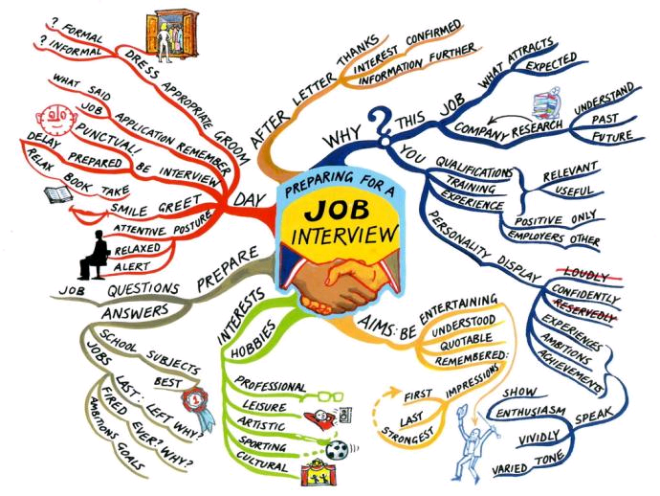

Slide 5
Takeaways from 2014-15 panels
Standing out in the online application process
  Be honest
  Provide clear descriptions of your experience relevant to the job
  Upload resume in pdf format, MSWord format can be lost in online system
  Cover letter is your chance to standout in online applications, create a different letter for each position applied for
  Specifically address the requirements for that job in the cover letter; use key words from the job description in the ad
  Highlight innovation in your experience, whether paid or volunteer
  Address the requirements of the job description on your resume, in your cover letter, in experience descriptions. Pay close attention to the Preferred Qualifications.
  Fill in all basic information on the online form, don’t leave blanks or try to adapt the form. The application is a ‘legal document’ so be accurate and complete.

Slide 6
Takeaways from 2014-15 panels
Interview preparation
  There will often be non-librarians on the search committee, so speak in terms anyone can understand
  A good presentation can win over lack of experience
  Present your true self; tell the interviewers what skills/qualities you will bring to help them in the position
  Have questions to ask the search committee
  Research the institution, read the college strategic plan or mission, look for current initiatives and focus. Visit the library either physically or virtually.
  Telephone interviews are common first interview, you can show your communication and public service skills during these. Some or all of the same questions may be asked in an in-person interview so answer carefully.
  Customer service skills are valued in most library positions. It’s not about working with books, it’s about working with people!
  Follow up the interview with an thank you email.
  Bring a positive vibe to the interview, even if you are nervous.

Slide 7
Further information
Hiring Librarians http://hiringlibrarians.com/ Blog that allows “people who make hiring decisions to explain their enigmatic thinking.”
LIS careers http://liscareer.com/index.htm Practical career development advice for new librarians and information professionals, MLS students, and those considering a library-related career.
Ask a Manager http://www.askamanager.org/
Open cover letters http://opencoverletters.com/ Anonymous cover letters from hired librarians & archivists
INALJ http://inalj.com/ Information professionals working to help find & share jobs & job hunting advice

