Slide 1

The Library Field of Dreams:
Hitting a Home Run with Faculty Outreach
Catherine Tingelstad, Wake Tech CC
Angela Davis, Pitt CC
NCCCLA Conference
March 17, 2015
If you build it…they might come!

Slide 2
If you build it…they might come!
Relationships
Resources
Reputation

Slide 3
If you build it…they might come!
RELATIONSHIPS

Slide 4
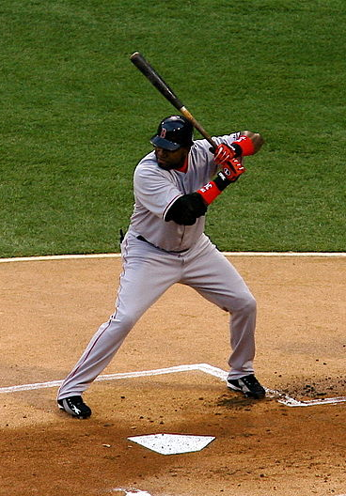
Step Up to the Plate
Get out of the Library!
Participate in campus activities & committees.
Track campus changes and developments.
How can the library fit in to new areas, curricula,
and programs?
Image: Big Papi via Wikimedia

Slide 5
Identify Faculty Needs
  Determine subject areas, courses, and assignments
  that require the use of library resources.
Buchanan, H., Webb, K., Houk, A., & Tingelstad, C. (2015). Curriculum Mapping in Academic Libraries.
New Review of Academic Librarianship, 21(1), 94-111: doi: 10.1080/13614533.2014.1001413

Slide 6
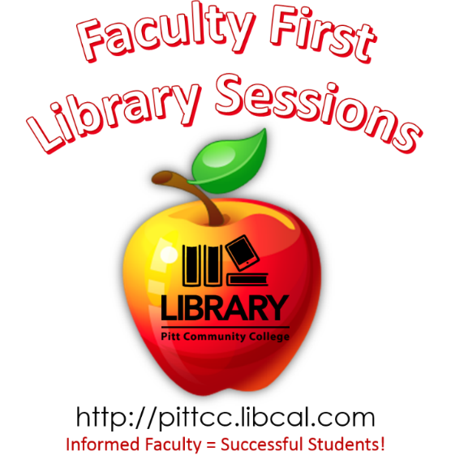

Try New Approaches
Be proactive!
Think outside the box.
Create professional development
opportunities.
Partner with campus programs.
ASK to participate!
Share library space.
Notes:
Be proactive: Make libguide first, then show to teacher/dept.
Think outside the box: use libguides for other purposes - reaccreditation site visits. What about you? Have you used libguides in different ways?
Faculty orientations, curriculum committee participation, onboarding, web advisory committee, distance ed club

Slide 7
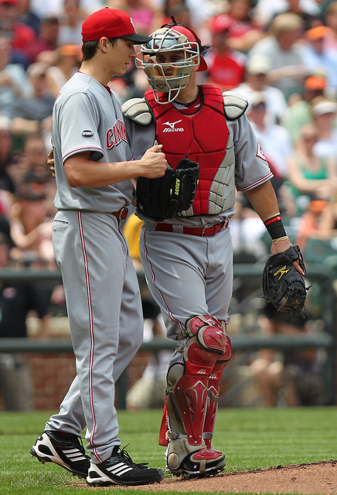
Communicate!
Know their preferences
Email schedule
Keep it short & simple!
Meet face-to-face
Offer to go to them!
Develop thick skin
Image: Cincinnati Reds catcher Ramon Hernandez (55) and starting pitcher Homer Bailey (34) by Keith Allison via Flickr

Slide 8

Building Relationships
What keeps you from building relationships with faculty members?
How can you overcome
these barriers?

Slide 9
If you build it…they might come!
RESOURCES

Slide 10
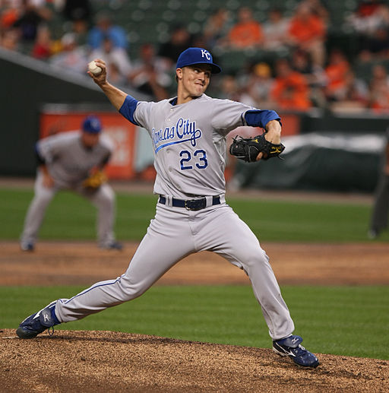
Customization is Key
Modify guides, handouts, and instruction for
particular classes or
assignments.
Incorporate their goals and objectives when appropriate.
Simple changes can go a long way.
Image: Donald Zackary "Zack" Greinke, American Major League Baseball starting pitcher via Wikimedia

Slide 11
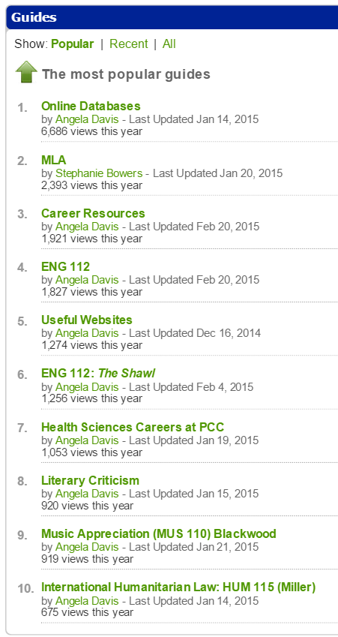
Most popular guides:
Highly customized for very specific assignments and classes
Updated often
Requested by instructors
Introduced during instruction sessions

Slide 12
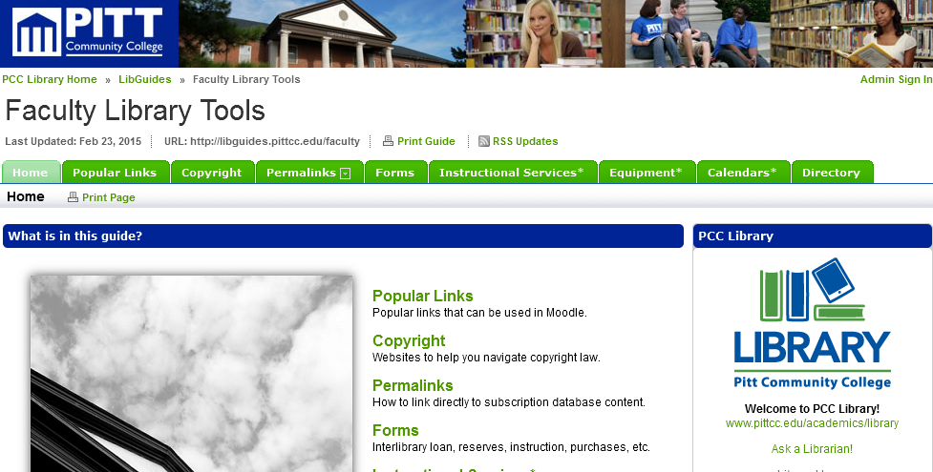
Faculty Library Tools
Feature specific services and resources
that will meet their needs.

Slide 13
Building Resources
Are your resources based on what is actually needed – or are your resources based on what YOU want to create?
How can you customize your
resources to meet faculty needs?

Slide 14
If you build it…they might come!
REPUTATION

Slide 15
Expand Your Influence
Develop a positive presence across campus.
Be a strong advocate for the library!
Expect that faculty will share their successes.
Informed Faculty = Successful Students!
Maintain faculty relationships.
Keep in touch and update resources.

Slide 16
Document Successes
Keep statistics:
  LibGuide hits, instruction sessions, web analytics
Gather feedback and comments:
  Instruction evaluation forms
  Yearly library user survey
  Phone and face-to-face conversations

Slide 17
Share Your Successes
Tell faculty members what has been successful
Show that the library supports success
  Congratulate via social media
  Display projects, art, pictures
  Ask how student papers turned out
Project an attitude of
cooperation and support!

Slide 18
Building a Reputation
How is your library currently perceived
on campus?
How would you like for your library
to be perceived on campus?

Slide 19
If you build it…they might come!
FACULTY PERSPECTIVES

Slide 20
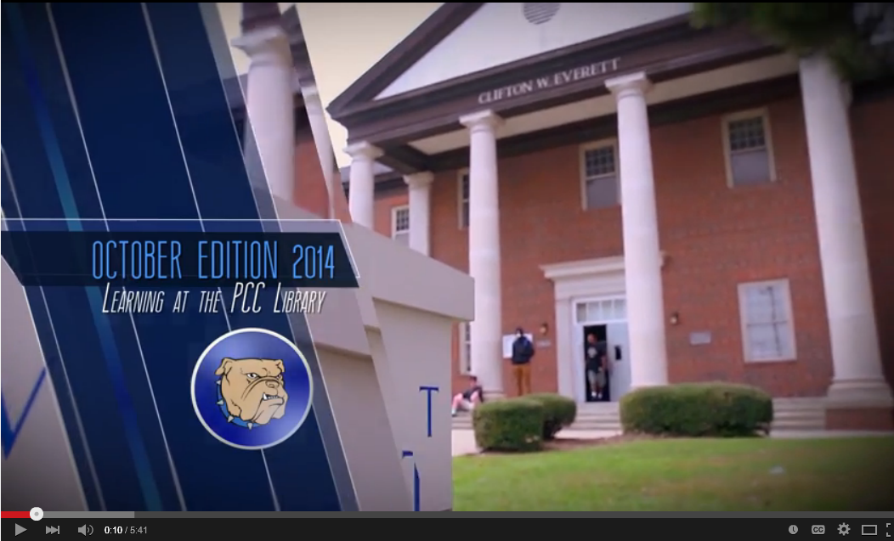

HOME RUN!

Slide 21
HOME RUN!
“A website for my specialty was added, and it has produced dramatic improvement
in my students’
performance.”
February 2015 Library User Survey

Slide 22
HOME RUN!
“I appreciate all of their help in
co-teaching research to my students.
I have had some of the best papers handed in ever since I began using
the Library’s instruction and
worked with the librarians
to create LibGuides.”
February 2015 Library User Survey

Slide 23
If you build it…they might come!
Relationships
Resources
Reputation

