Slide 1
Keeping the Library Relevant as a Learning Center
NCCCLA 2015
Wake Tech Community College
March 16, 2015
Michael Crumpton
Nora Bird
University of North Carolina at Greensboro

Slide 2
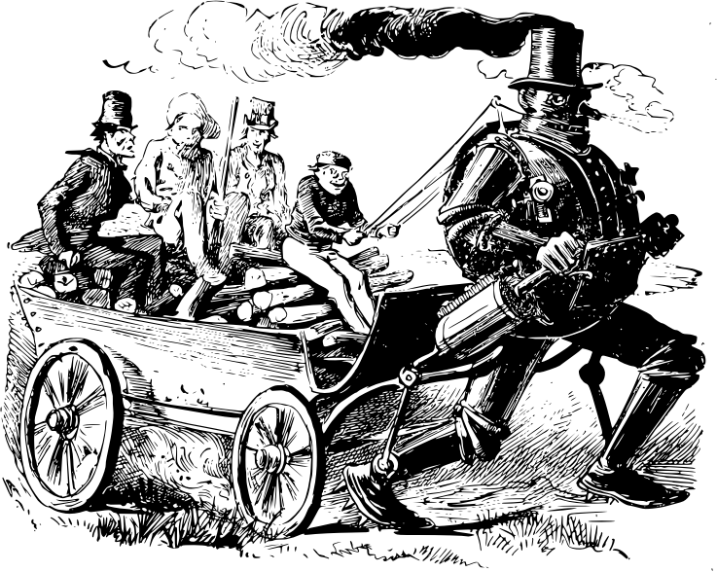
What is a Librarian?

Slide 3
What does CHANGE mean?
The Process of Becoming Different
To Transform or Convert
A Transformation or Modification; Alteration

Slide 4
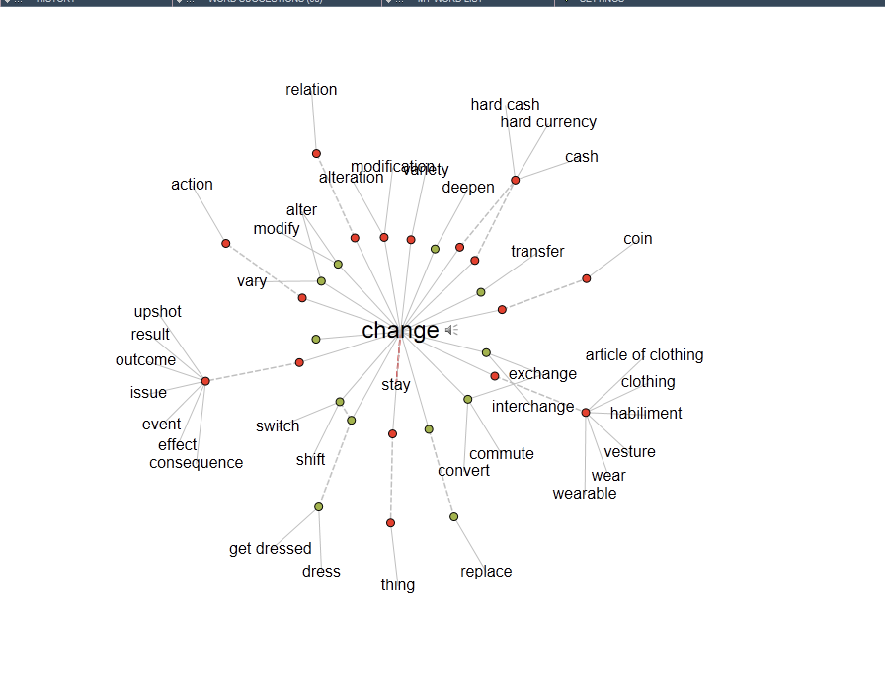

Slide 5
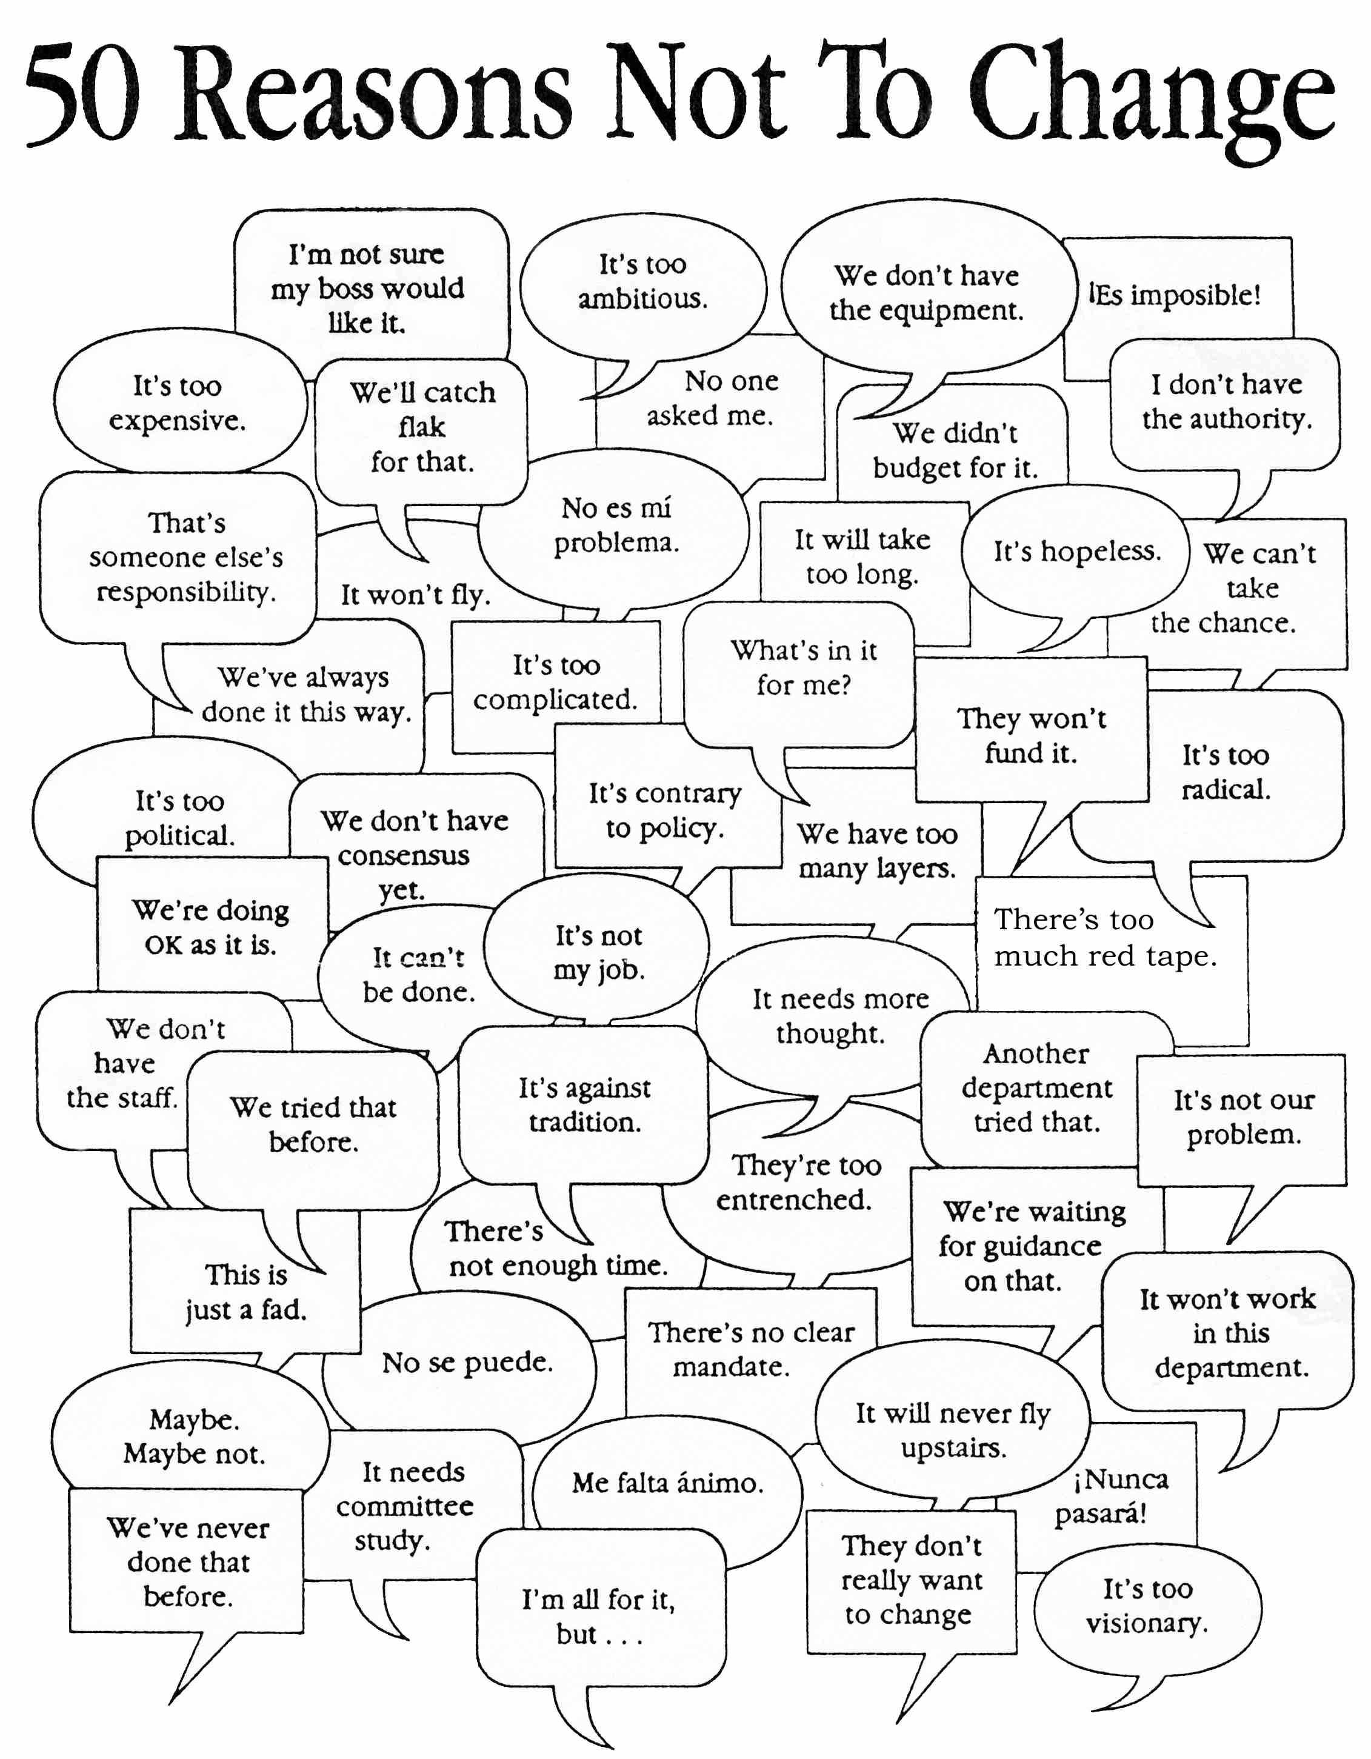

Slide 6

Top Ten Academic Issues
Alternative higher education choices
Shifting staff
ACRL Information Literacy Framework
Transition to Openness
Digital education
Ebooks
Student data
Leadership

Slide 7

ROI/Community Support
Can an academic library properly demonstrate return on investment?
Lib-value project
Future of the library task force
  Focus on literacy
  Fundraising
  Volunteers
  Measure impact

Slide 8
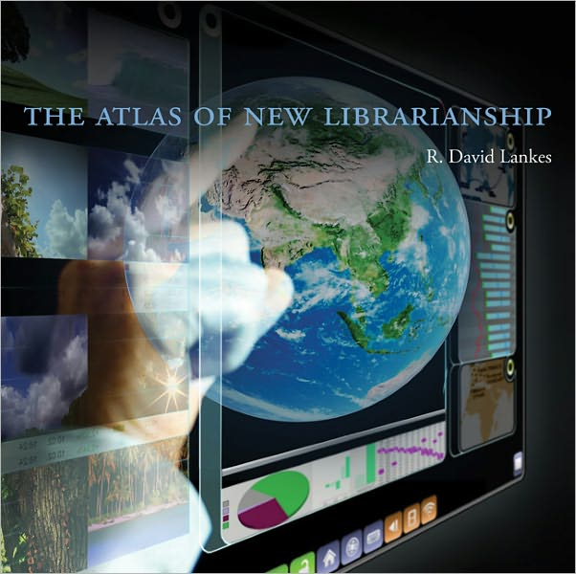

Slide 9
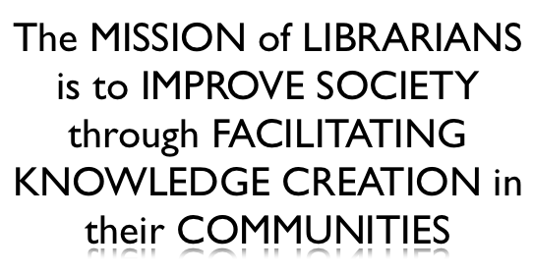
Lankes’ Fundamental Point

Slide 10
Radical Conversations
Programming that promotes and transforms student learning
Libraries create, are special, not testing centers or supreme authority
Demonstrating conversations with community and value gained
Focus on knowledge
Tell stories of impact with students and community

Slide 11
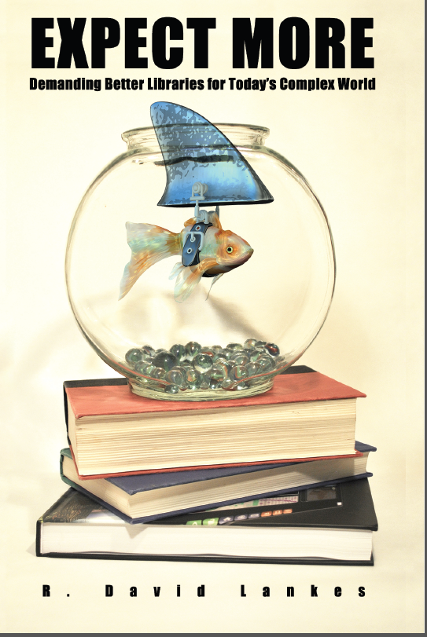

Slide 12
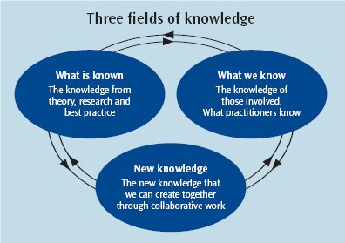
Changing Roles
Gatekeeper of culture
Facilitating conversations that foster knowledge construction

Slide 13
Seth Godin
Seth’s Blog: The Future of the Library
Seth’s proposal for economic shortfalls: “train people to take intellectual initiative” to find and connect to information already out there

Slide 14
Pivot Points for Change
Keep the machines in your factory but change what they make
Keep your customers but change what you sell
Keep your staff but change what you do
Keep your mission but change your scale
Keep your technology but use it to do something different

Slide 15
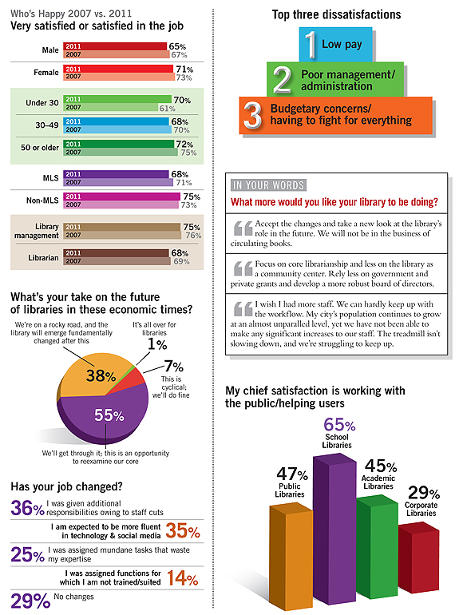

Slide 16
Culture of Accountability
From “Change the Culture, Change the Game”, Connors & Smith
  Leaders must create needed culture
    Must have a direction/goals
  It’s the culture that produces the results
    If the culture doesn’t change nothing will
  Accountability is the key
    At multiple levels

Slide 17

What causes Conflict?
Issues
Print vs. electronic
  Who manages?
  Who is engaged?
Administrators vs. faculty
  Costs vs. format of use
  Who advocates for what?
How to resolve

Slide 18
Areas of Conflict
Growing pains
Information overload
  Who to manage and curate?
Administrative vs. faculty (POV)
Leadership perspective

Slide 19
Academic Library Contributions to Student Success
From Assessment in Action Projects
  Student confidence in research activities
  Contributes to retention and persistence
  Library instruction connected to higher grades
  Space fosters social and community academic works and activities
  Games/programming engage students and learning of IL skills

Slide 20
Cultivating Community
Service learning
  Validation and motivation (confidence)
  Hands-on learning (practice)
  Career preparation
Information literacy component
  Adds how and whys
  Helps explore research potiential

Slide 21


Slide 22

Suggestions
Be Nimble
Be adaptable
Know the values
Have a plan
Communicate
Be visible
Be transparent
Be positive

Slide 23
Community College Libraries: More Relevant than Ever
An ACRL e-Learning Online Course
April 13-May 15, 2015
Description: This five week course offers 1.5 hours each week on topics of interest to new and experienced community college librarians. The topics covered will be:
Advocating for Your Library - Advocacy is often talked about as a political activity but it really means connecting with all constituents including faculty, staff, and students. The importance of relationship building through implementing a comprehensive advocacy plan will be discussed.
Assessment of Library Activities - One major part of successful advocacy is to be able to show how faculty, staff, and students are using the library. Types of assessment will be described and attendees will be asked to choose one or two that might be implemented in their own library.
Embedded librarianship - There is a wide range of services that have been labeled with this heading. The presenters will cover how this service has been implemented in several libraries and ask the attendees to design a possible service for their situation.
Instructional design - Many librarians were not taught how to teach. The presenters will cover general instructional design theory and attendees will try to revamp a particular class that they teach.
Supervision - Many first-time librarians are asked to supervise immediately when taking a position in a community college. Strategies for becoming a successful supervisor will be covered in this part of the course.
The presenters are the co-authors of Handbook for Community College Librarians, published in 2013 and experienced community college librarians.
Learning Outcomes:
Understand and value the unique and diverse mission of community college librarians in support of their institutions goals.
Design programs that fit an individual community college in the areas of instruction and embedded librarianship.
Implement strategies for better employee supervision and efficiencies.

Slide 24
Resources & References
Burnes, Bernard, and Philip Jackson. "Success and Failure in Organizational Change: an Exploration of the Role of Values." Journal of Change Management 11.2 (2011): 133-162. Web.
Connors, Roger, and Tom Smith. Change the Culture, Change the Game. New York: Portfolio/Penguin, 2011. Print.
Godin, Seth. "The Future of the Library." Seth's Blog. N.p., 16 May 2011. Web. 18 May 2011. <http://sethgodin.typepad.com/seths_blog/2011/05/the-future-of-the-library.html>.
Hamilton, Buffy J. "Pivots for Change: Libraries and Librarians." Library Media Connection. Linworth Publishing, May & June 2010. Web.
Lankes, R. D. The Atlas of New Librarianship. Cambridge, MA: MIT Press, 2011. Print.
Lankes, R. D. Expect More: Demanding Better Libraries for Today’s Complex World. www.DavidLankes.org, 2012. Print.
McKnight, Michelynn. The Agile Librarian's Guide to Thriving in Any Institution. Santa Barbara, CA: Libraries Unlimited, 2009. Print.
http://www.oclc.org/research/events/2011-06-08.htm
"Adaptability: the New Competitive Advantage." Harvard Business Review. Harvard Business Publishing, July & Aug. 2011. Web.

