Slide 1
Patron Data Loads in CCLINC
History, Test Case @ Surry CC, & Future
NCCCLA March 17, 2015

Slide 2
History
Original contract for Library System ca.2000
November, 2012 Meeting @ System Office
Spring, 2014 Conversation with Surry IT staff member
Begin to develop requirements for getting report from Elucian to be uploaded to Sirsi/Dynix
August, 2014 – FERPA discussion at Director’s Institute
December, 2014 – 1st test load of records
February, 2015 – Purging records in preparation for data load

Slide 3
Informer Reports from Elucian
Must be able to get a report that is in a Flat ASCII file in its final form
Outputs from Elucian typically are in Excel file form
Process at Surry CC

Slide 4
Next Steps
Recommendation to CCLINC Steering Committee for list of “essential (basic) fields” that must be extracted from Elucian
Make recommendation that Prefix system for Item records be adopted for Patron records
KISS Principle – must all follow same protocols and procedures
Bring 3-5 more libraries on board by Fall, 2015 or Spring, 2016
Available to all Fall, 2016

Slide 5
Preparing to
Load Records
Clean-up of current records
Create lists, manual deletions
Request purge of records if not already in a cycle
Discuss how your library’s current protocols/procedures will have to change

Slide 6
Preparing to
Load Records
How will you implement the new procedures
Each campus situation will be different (Student IDs, library cards, etc.)
Talk to your campus IT staff. Tell them what you need.

Slide 7
Loading Records
Procedures in process
Sample test load is mandatory
Must have an FTP program on your computer. We use FileZilla
FTP file to John Wood at System Office via VPN—he gives you the address for the Test Server

Slide 8
Crucial Considerations/Requirements
Sirsi/Dynix ID # field – the unique number generated from Elucian report
SCC’s Prefix 23252 in S/D for patron records

Slide 9
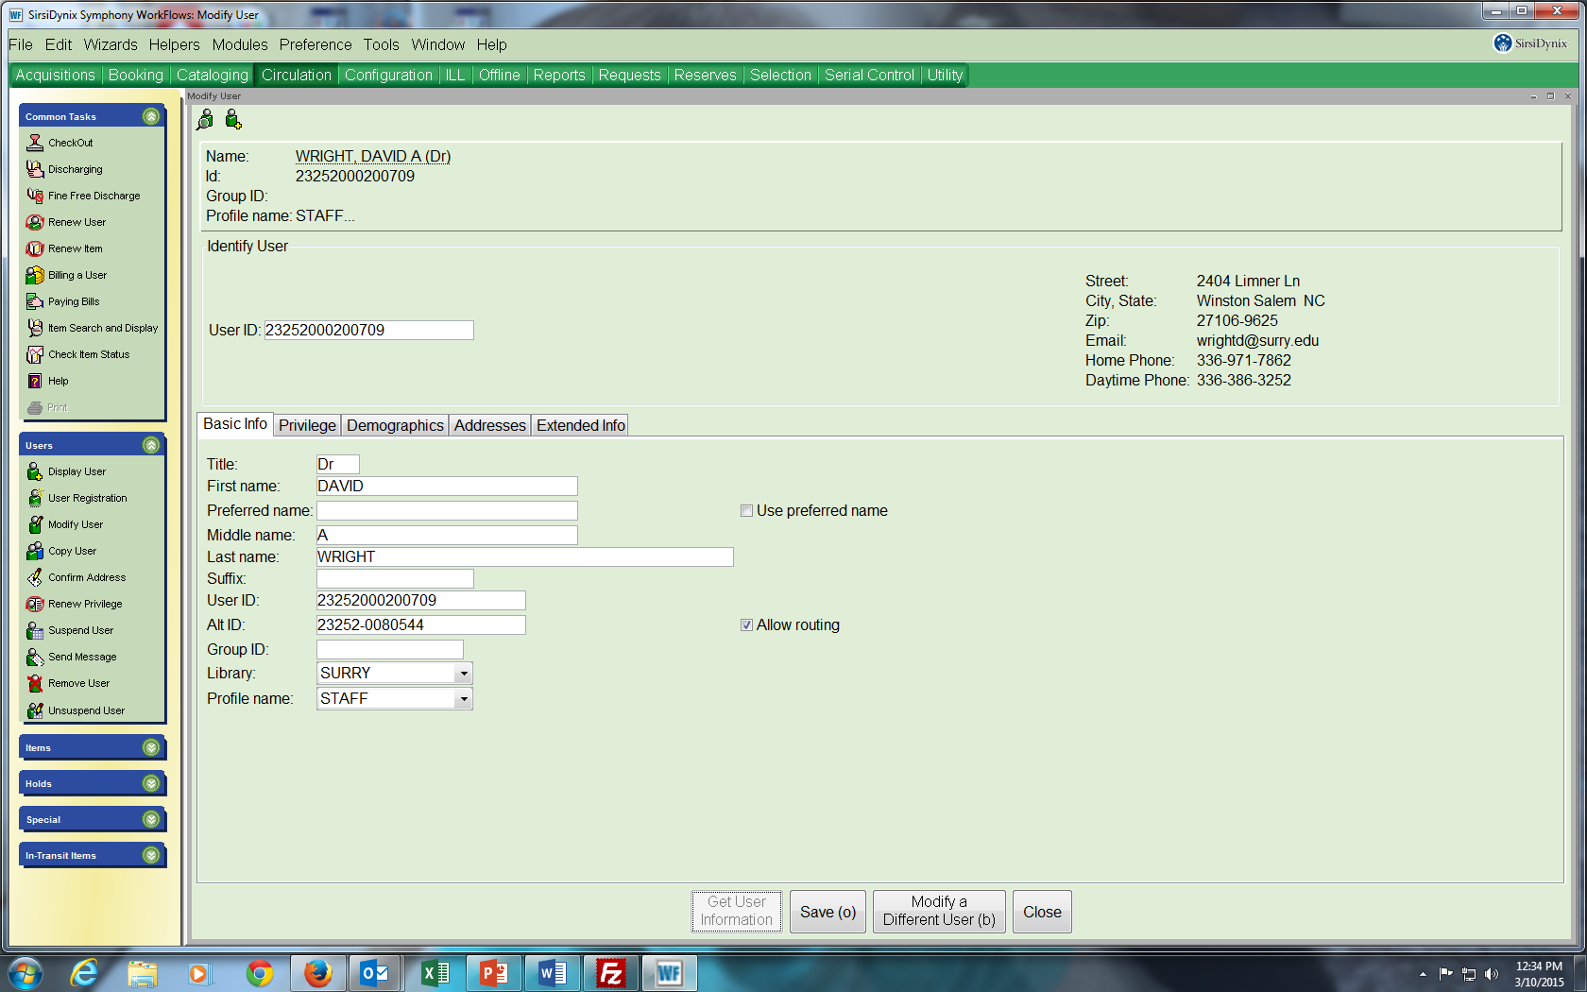
23252-008000
xxxxxxxxxx
xxxxxxxxxxxxxx
xxxxxxxxxxxxxx
xxxxxxxxxxxxxx
xxxxxxxxxxxxxx
23252-008000

Slide 10
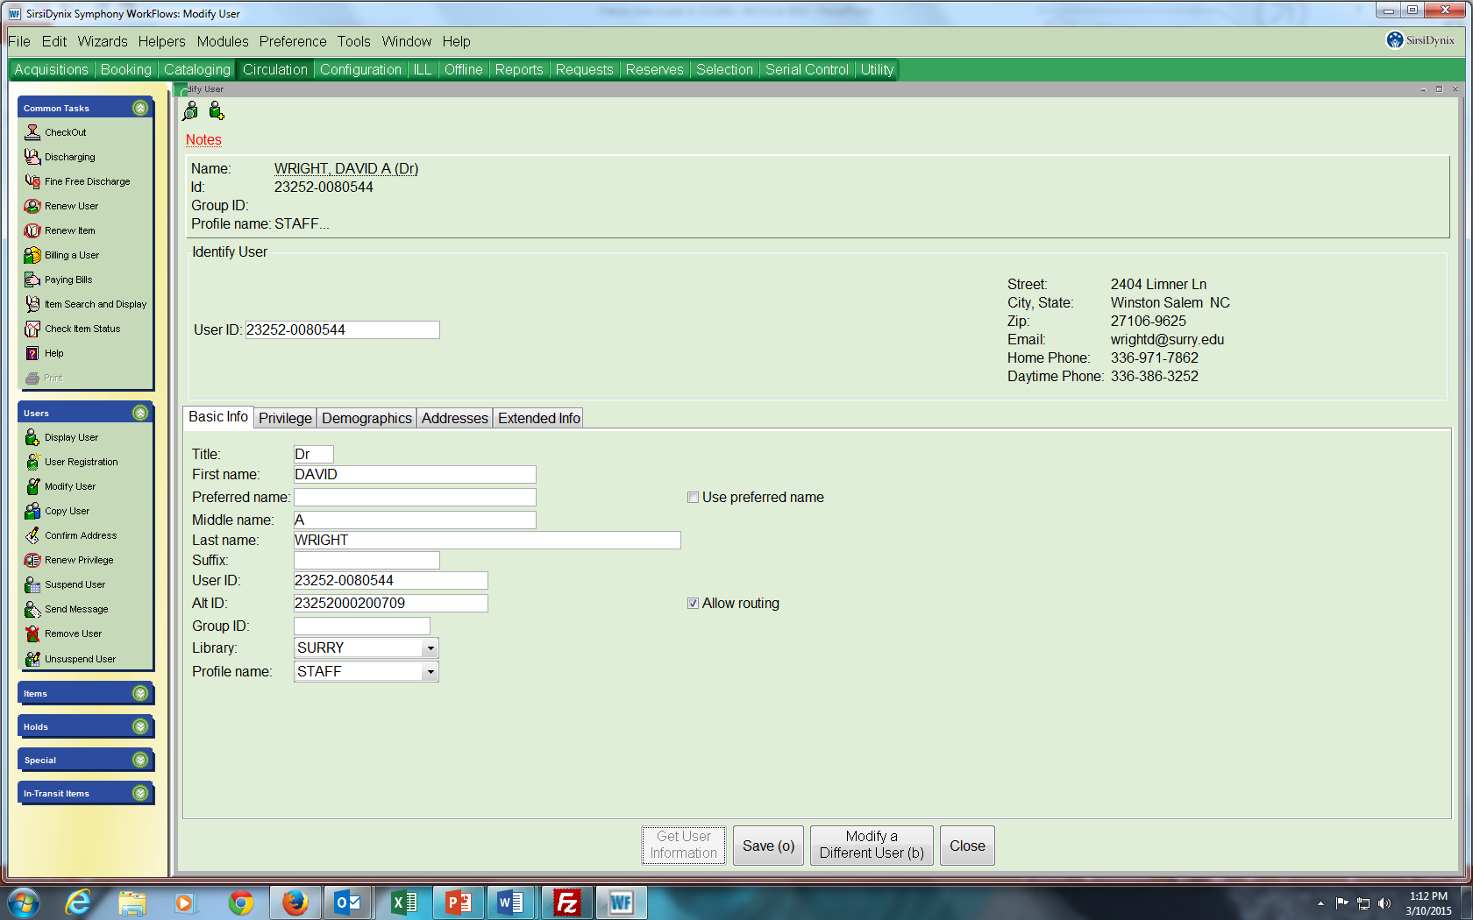
23252-008000
xxxxxxxxxx
xxxxxxxxxxxxxx
23252-008000
xxxxxxxxxxxxxx
xxxxxxxxxxxxxx
xxxxxxxxxxxxxx
23252-008000

Slide 11
Sample of Record Fields for Sirsi/Dynix system
Sirsi/Dynix information from Chapter 7 (User Record Formats) available from S/D website via login
Example of sample fields (handout)
Example of student record from Elucian Informer report (handout)
Consult Load User Report in S/D documentation – John Wood is only authorized person to load these reports

Slide 12
Questions to Ask--
Concluding remarks
Do Library staff members want to quit manually entering records?
Are you willing to change your present procedures and protocols to conform to the parameters of the Patron Data Load requirements?
Who will you need to enlist on your campus to help and support you through this process?

