Slide 1
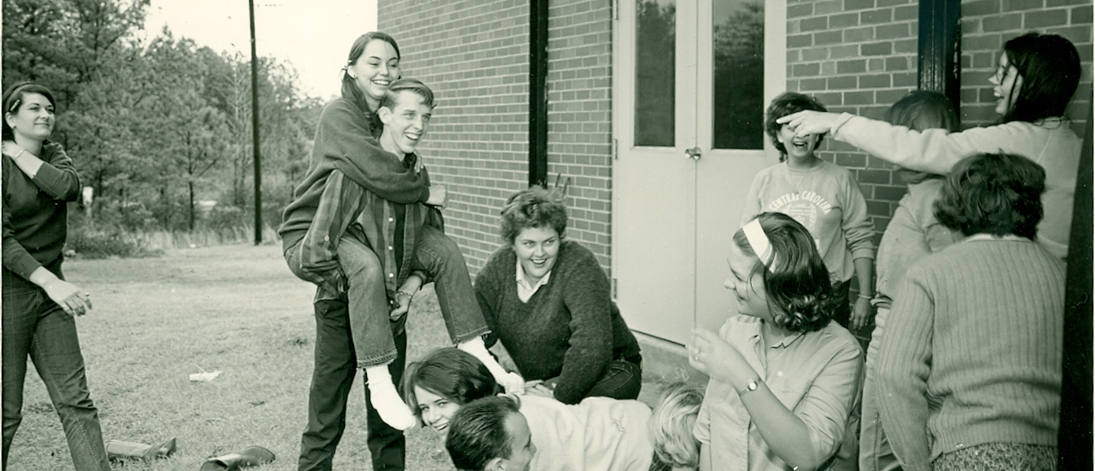
Outreach and Archives: Building Community Investment by Building your Archives
Notes:
Welcome. Thank you for joining me today. We’ll be talking about archival work today. However, I don’t plan to get into too great of detail about the process of archives. We’ll certainly cover some of the basics, but I want to hit more on the concept of why we do archival work. Right now, I’m sure every person in this room has some experience with understaffing. WE all need to prioritize right now. So why spend our time with such a huge project? Certainly there’s historical value there, and preservation is important, but it can still be hard to justify putting so much time and effort into a project whose value really won’t be apparent for decades to come.
That’s really the heart of what I want to get at today. I want to talk about some of the immediate value available from a working archive. Obviously, providing access to these documents and artefacts can have some immediate value for patrons interested in searching them. But even more pressing, I think, is the value to be gained in terms of outreach that these materials provide. There are activites we’ver been undertaking at CCCC using our archival materials that are helping us to build our community’s investment in our library, and I think that type of value is worth looking into a little more deeply.

Slide 2
The concept of preserving history, collating full archives, making them as usable as possible so the public have access to them, I really feel that it allows the public an ability to engage with their own history.
--Sarah Harrison
Notes:
I wanted to start with a quote that speaks to the ideas we’ll be discussing today. {read}
Now, Sarah Harrison is part of the wikileaks controversy, so when you unpack what she’s saying here in that context, you may or may not agree completely with what she’s saying. But looking at it through the lens of a library’s historical archives, I think it has something valuable to say. Making your archives accessible allows your users to engage with them, and with their own sense of their role within the history of your institution, builds an incredible sense of community. That’s the idea we want to tap into with using archives for outreach, and that’s the heart of what I want to talk about today.

Slide 3
The Archives at Central Carolina Community College: an overview.
Creating a useable archives at your college library: some tips and advice.
Marketing and outreach with archival materials: make them work for you!
Notes:
Content of the Presentation:
First we’ll go over the Archival collections at CCCC, and talk a little bit about the scope, and about our general plan for these materials.
Next, we’ll discuss a five step method for organizing your archives in an accessible way.
Finally, we’ll talk about some ideas for getting immediate value out of your accessible and useable archives through marketing and outreach.

Slide 4
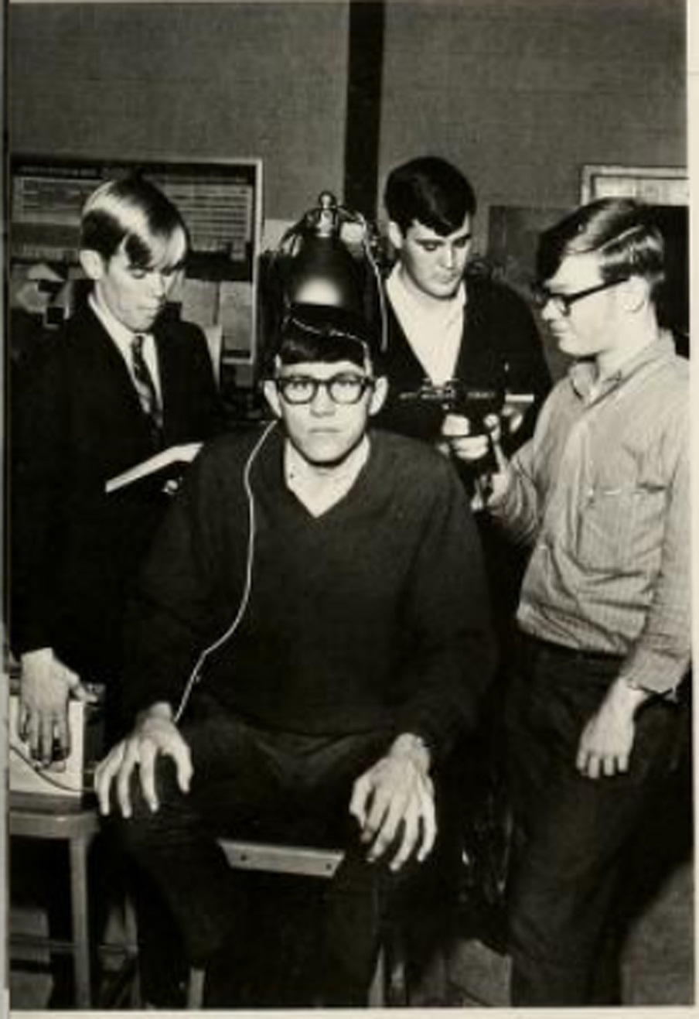
Scope of the Project
Preservation + Access
Notes:
The Archives at CCCC cover a lot of ground. They’re comprised of 5 Groups or Collections.
Our general goal in developing and maintaining each collection is to collect, organize, describe, make available, and preserve primary and secondary resource materials documenting the history and development of the College, its growth and activities within the community, its classes and programs of study, as well as the contributions of individuals and groups associated with the College.
The activities involved in this project cover a dual agenda: both to preserve these materials, thus ensuring long-term value to our institution and community, and to make them as accessible as possible, thus ensuring immediate value to the institution, including the library itself.

Slide 5
Our Archive Mission
The mission of the Archives is to preserve a historical record of the educational programs and activities of Central Carolina Community College, and to ensure ongoing access to items of unique historical and educational significance to the college community. In so doing, they strive to support the mission of the Central Carolina Community College Libraries: to provide information access and to promote information literacy in supporting the educational programs and mission of the college.
Notes:
I want to take a quick look at our archives’ mission statement. Well talk about the importance of a mission statement a little later on, but I want to highlight a few sections of ours. [read]
This statement does three things: it lays out our goal of preservation, as well as our goal of access. It also ties the archives directly to the library. This is important if you want to ensure that the library maintains control over these collections in the future.

Slide 6
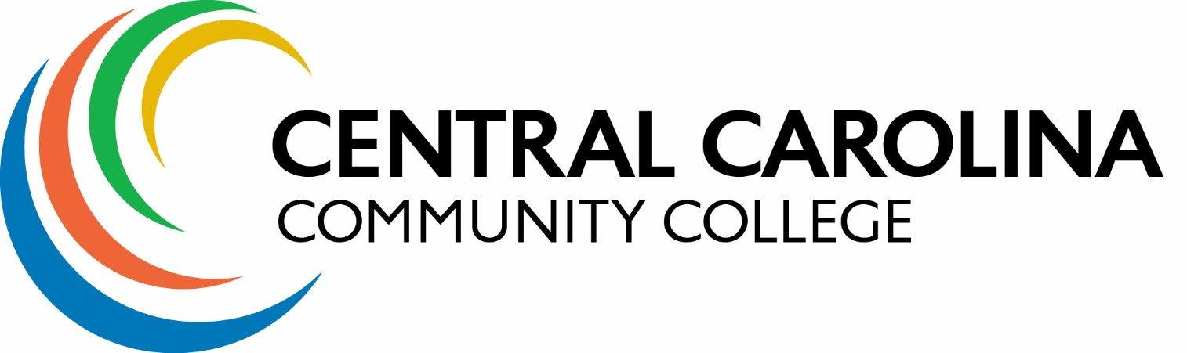
Collections
PHOTOS (~13,000 Images)
SCRAPBOOKS (Newspaper Clippings, Photocopies)
MULTI-MEDIA (VHS, Reel-to-Reel, Slides)
COLLEGE HISTORY (Yearbooks, Catalogs, Faculty Newsletters)
MISCELLANEOUS (Artwork, Maps, Sports Memorabilia)
Notes:
Our photo collection is definitely our big one. It includes more than 13,000 images in 33 boxes. These span all the way back to our founding. Additionally, this is really the collection that’s likely to bring us the most immediate value, so it’s where a lot of the focus of this project is.
Next, we have a small collection of scrapbooks. These are primarily newspaper clippings, but also include photocopies from local Sanford and Lee county publications. The focus with this collection in truly dual, since these have some historic significance, and preservation is a fairly daunting task. The idea is to preserve them, while creating a highly searchable digital collection to eliminate the need to unbox the originals.
Our multimedia collection contains about 45 VHS tapes and 13 audio reel-to-reel tapes. The goal here really is on digitization, since there’s not a huge amount of value in preserving the physical container, only the content.
The largest and most diverse collection is college history. This is where you’ll find out yearbooks, faculty newsletters, course catalogs dating back to the first semester at CCTI. At this point, we’ve digitized the yearbooks and some faculty newsletters, but much of this collection is being pushed to the back burner.
Our miscellaneous items include a pretty interesting collection of maps for lee county dating back to the 50s and 60s, and quite a bit of random artwork.

Slide 7
5 Steps to a
Useable Archive
Notes:
So now that you know a bit more about what we’re doing at CCCC, let’s talk about the nitty gritty details of how you can implement a similar project with your archival collections.

Slide 8
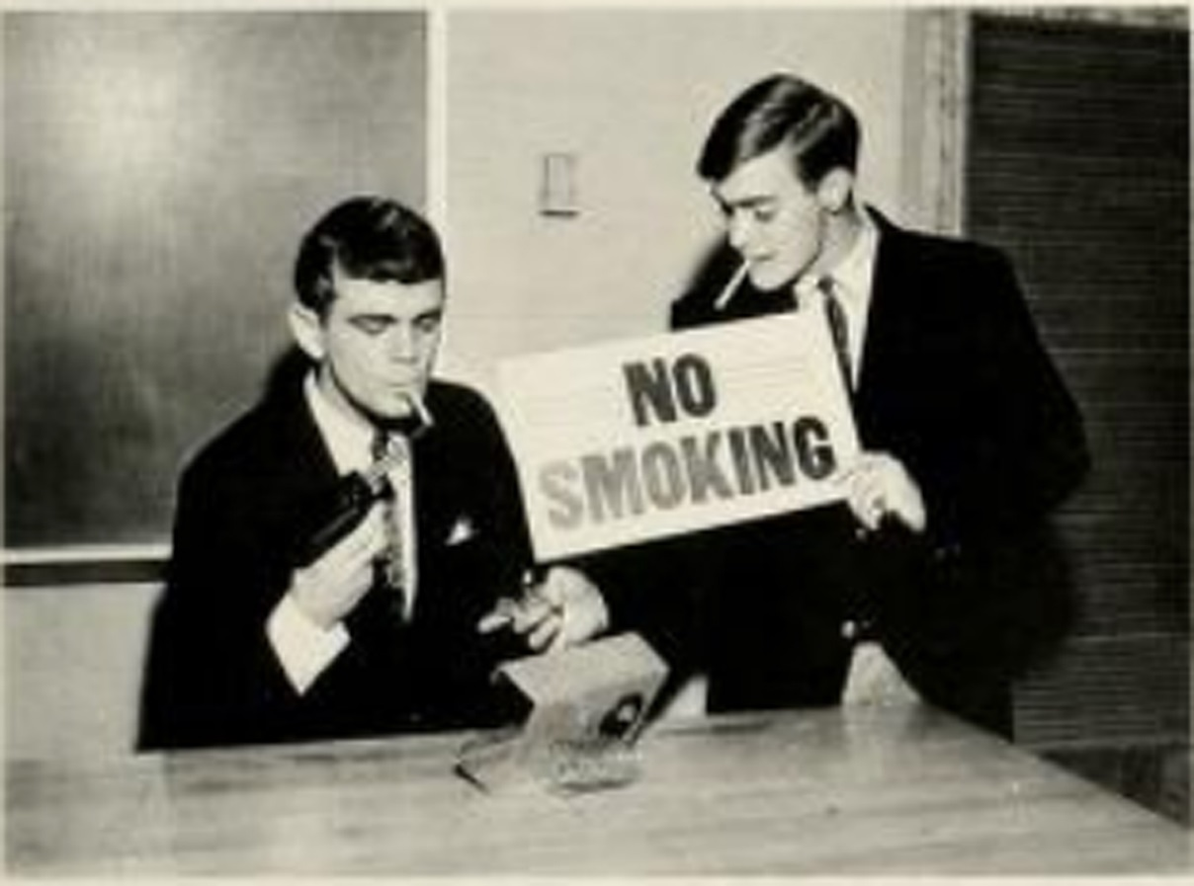
STEP ONE: Documentation
Mission statement
Acquisitions policy
Deaccession policy
Donor form
Workflow
Notes:
I think one of the first things you need to do when setting out to create a useable archival collection is to work out all your documentation, starting with a mission statement. This is pretty vital to your archives for a few reasons, for one, it lays out why maintinag the archives is important. If you find you need to justify costs associated with supplies or staff time use, the mission statement is a good thing to point to. Secondly, the mission statement explicity ties the library to the management of the archives. Finally, your mission statement identifies the purpose of the archives. For CCCC, that’s a dual purpose of preservation and access. If you leave your job, and a new employee takes over your archives, you want to ensure that they share the same goals as those created on your watch.
Next, you really need an acqusitions policy. This lays out all the rules for ensuring that you maintain your archives focus. This is wear you point a patron when they’re trying to convince you to accept a donation that doesn’t fit your archive’s scope.
Let me tell you about one of our weirdest archival artefacts to illustrate why it’s so important to create this documentation. Our archvies room is in the process of transition. The materials are being moved to a larger room closer to my office, but many are still housed in what is basically a closet. On the floor of this closet is a huge, and I mean it takes up a good 10 percent of the floor space, wooden carving of Abraham Lincoln's head with a 2x4 sticking out of it. You may be wondering what this has to do with central Carolina community college or lee county. Me too. It was donated to us before I got here, by a former instructor who bought it on vacation in southern California. He then donated it to the library’s archives in memory of his mother, who was in no way affiliated with our school. I’m not really clear how she was affiliated with Lincoln either. This was before we had any kind of donor form or acquisitions policy. I’m reminded of how important these documents are every time I go in that closet, because I stub my tow on the Lincoln head every single time.
Which leads me to an important part of the acquisitions policy: the deaccessioning policy. This is where you lay out the process by which materials can be removed from your archives, and the criteria by which you or your library staff, will make decisions to do so. For example, CCCC’s basically states that,because space is at a premium, we can remove items deemed irrelevant to the scope of our collection, too diificult to preserve, or better suited to another institution.
Keep in mind, it’s important to outline the steps you will take to ensure the lasting integrity of the document or artefact being deaccessioned. Our policy states that we will attempt to contact the original donor to return the item or learn their wishes for it. If, after 30 days, all attempts at contact have failed, we will seek a more appropriate institution to transfer the item to. If no institution is interested, only then wil we consider discarding the item.
Finally, the last piece of documentation you want is a workflows. This is simply a document that lays out a step by step procedure for processing archives, including the process for dealing with new acquisitions.

Slide 9
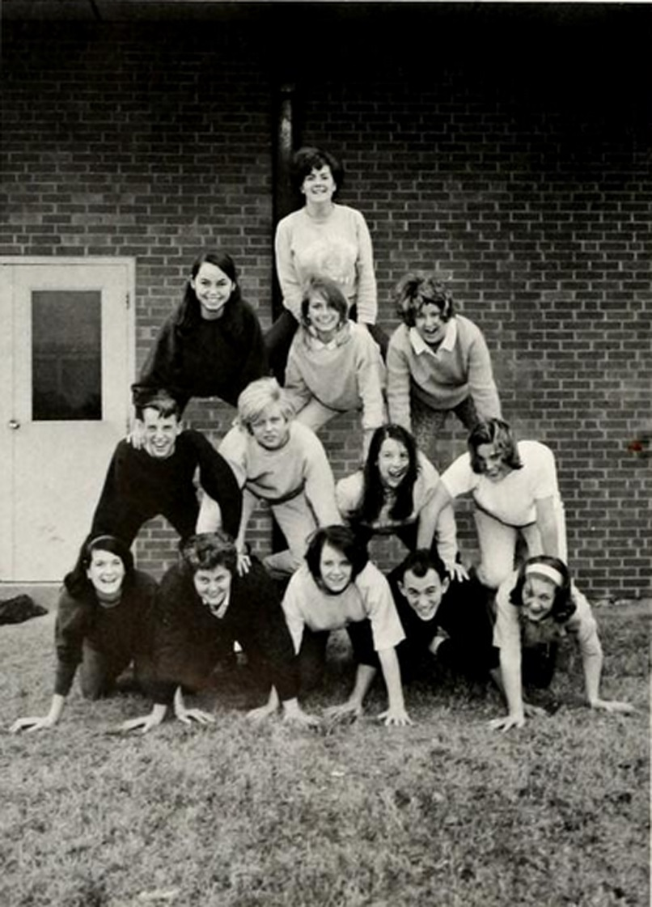
STEP TWO: Organization
Take stock of what you have
Identify series and files
Determine supply needs
Box it all up
Finding aids
Notes:
So, like any process, the step by step outline I’m giving you is somewhat misleading. You’ll likely go back and tweak your documentation, particularly your workflows, as you move forward in the process. However, getting the bulk of that documentation done before you thik about organizing is going to make your next step easier, because it gives you a framework and a strong idea about the scope of your collection. This will help you develop an organizational ystem that works for you.
The first step to developing this system is to know what you have. How many different groups or collections will you be working with? Approximately how many documents or artefacts does each collection contain?
From there, you can outline the series and files within each group or collection. We’ll talk a little more in detail about what that means in the next step. At this point, all you really need to think about is what levels of arrangement you’ll be doing, and the basics of how you’ll be describing those levels. For example, when I did my overview of the photo collection, I identified 18 series including faculty, students, entertainment, facilities, and others. I did add two more series when I got to work describing the archives, but it made the descriptive process much quicker to already have htat level of description taken care of. Also, this is the point where you think about whether your arrangement will be purely intellectual--that is, the items will be listed by series and file I nyour finding aid, but will be arranged either in original order or in an order that makes the most sense physically speaking—by size, for example.
Next, you’ll need to determine your supply needs. I garuntee that you’ll need more supplies that you expect, and will end up ordering more than once. But for budget planning purposes, getting at least a rough idea of the supplies you’ll need will go along way. Think about the different types of storage you’ll be doing: photo boxes, document storage, file folders, plastic sleeves, etc. Will you need preservation supplies like acid free backing or sprays for newspaper clippings? I’m a big fan of Brodart for most of my supplies.
Next, Consider boxing everything up before you get down to the business of describing everything. This will mean the documents and artefacts are being stored in a more preservation friendly way then being left out in the open to fend for themselves in the face of humidity, light, and dust. It will also make each step of the descriptive process feel a little less overwhelming. It’s a lot easier for me to think in terms of finishing one box then in terms of describing an entire room of documents.
Finally, set up your finidnig aids. At CCCC we’re actually creating two fininding aids. One is a traditional flat finding aid in a word document. This is important to me because, once it’s printed, it doesn’t require any technology to use. Which means it will still be accessible in 30 years when our technology hasn’t completely changed. The second is an Access database. To be honest, this isn’t my favorite thing in the world I’m hping to get some nice archival software in the future that will create a more flexible database. But access at least gives us a base to work with for now. Determine how you will crete your finding aids, and set them up now, before you start writing your desciptions.

Slide 10
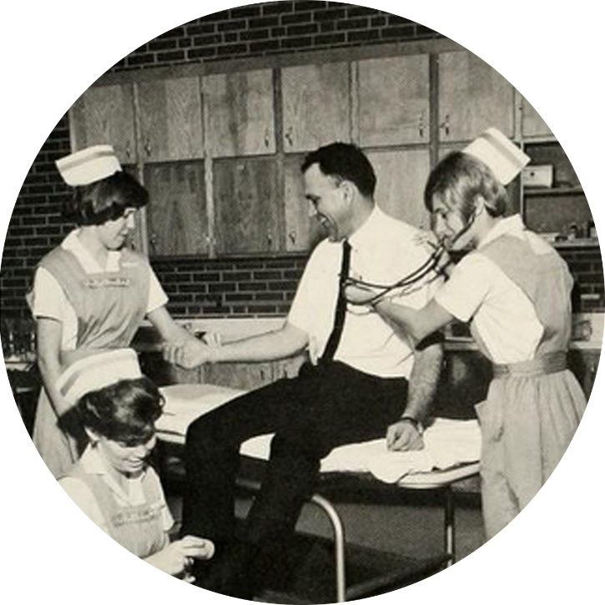
STEP THREE: Prioritization
Bang for your buck
Snowball effect
Notes:
Again, I want to emphasize the idea that these steps are not precisely linear. Be thinking about prioritization when your taking stock of your collections, for example, and be prepared to go back and change your plans for organization after attempting to prioritize. But that caveat aside, it will be easier to prioritize your work after you have some organizational boundaries set up.
When prioritizing our collections at CCCC, I thought about two major ideas. The first I’ll call “bang for your buck.” That sounds cutesy, but it sums it up. The idea is that you want to get the most immediate value for the least amount of wrk when you’re getting started to avoid getting overwhelmed and to ensure that you can start using your archives as a tool for library activites, and providing access to the most exciting archives to your communities. you may find that arragning and describing all your old course catalogs is really easy, but not many people care to use that collection once it’s available. On the other hand, everyone might be really excited about your photo collection, but if it’s so big it takes you five years to make available, it might be a better idea to start smaller.
A second idea to keep in mind is what I call the “snowball affect.” Again, a silly name, but it does get at the heart of what we’re trying to do here. If there are collections that naturally complement each other, do those first. For example, we did our yearbooks first. This provided great initial value for nt much work, but it also ended up being really handy when it came to working on the photo collection. If I’m having trouble identifying someone in an old photo, the first thing I do is log on to the NC digital heritage center and search our digitized yearbooks. If by describing and digitizing one collection, your are better equipped to deal with another collection, start there.

Slide 11
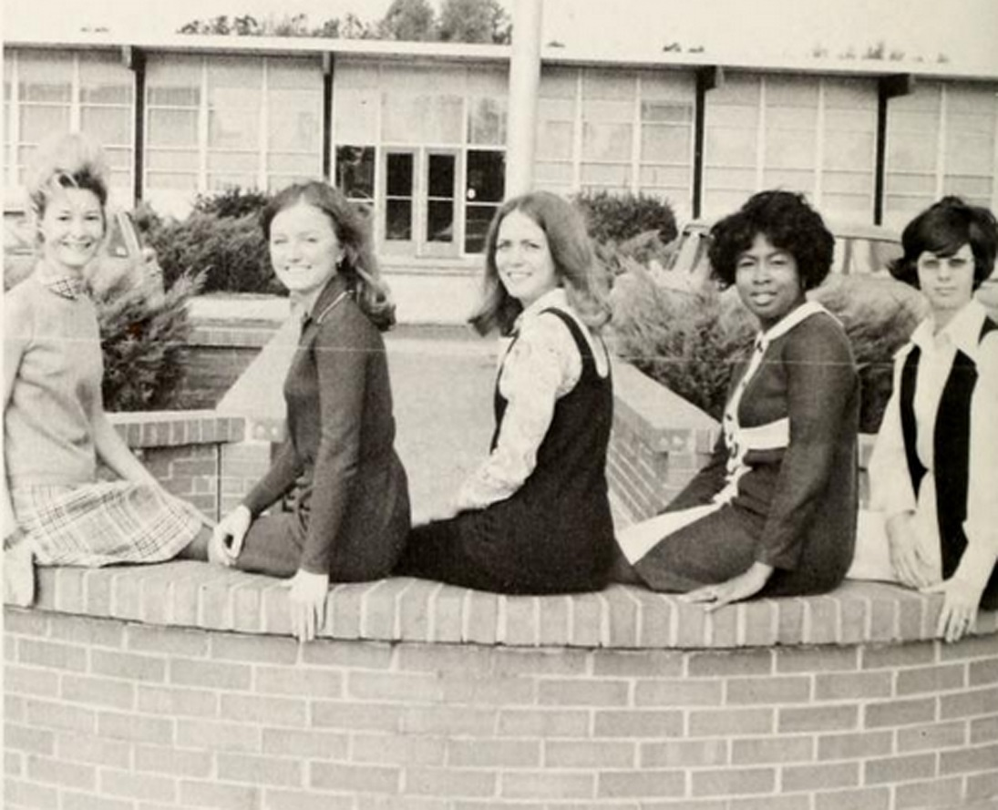
STEP FOUR: Arranging & Describing
Levels of arrangement
  Group/Collection
  Series
  File
  Item
Describing
  Content
  Finding aid
  Access points
Notes:
OK, so up to this point, everything we’ve talked about has been the “getting started” stuff. Now we’re ready to discuss the real meat of the project, and that’s arranging and describing your archives.
I want you to get an overview of the steps and general guidelines of archival processing, but if you want to dig deep, I suggest Laura Millar’s fabulous book, Archives: Principles and Practices. The information about this book is included in your handout, and I’ll give a quick list of resources at the end of the presentation as well.
The first thing to know about arranging and describing archives are the different levels of arrangement. This is what I was referring to earlier when I talked about identifying your series and files. The first level of arrangement is the Group level. These are the different collections within your archives: for us, this is photos, scrapbooks, college history, etc. You might chose more intellectual distinctions: maybe you have a collection of the working papers of an old instructor, or collections related to different programs. Choose your Groups organically, based on what you have. Next you have your series. For our photo collection, we have series such as Students, faculty, facilities, entertainment, etc. This is the level at which your groups subdivide, usually based on format, purpose, usage, or content. Our college history group is subdivided into yearsbooks, catalogs, newsletters, and things like that. Next you have file. This is even further subdived to describe the particular topic or subject covered by a group of documents or artefacts. For example, with a photos group, you might have a “Marketing campaings” series, and within that, a file on photos from the 1983 ad campaing. The final level of arrangement is the document. This is the thing itself: the photo or newsletter being preserved.
In addition to arranging your items, which will help with the creation of the finding aid, you need to create descriptions. These can be item level descriptions or, if you want to move quickly thorugh your collections, you can simply describe your files and series, leaving the docmuents ems to be catalogued later. However, if you plan to digitize through the NC digital heritage center, as we’ll discuss next, you will have to create item level descriptions, Including metadata in a number of fields. In your handout is a template for creating each descriptive file. Unlike library catalog records, the focus is not just on the content and structure of the item, but also on its context. When and why was it created? BY whom? How did your archives end up in possession of it. This is all important information when describing your archimal materials.
So where do these descriptions go? Into your finding aid, of course. There are multiple types of finding aids, and your choice of finding aid will based primarily on who will be using your finding aid. Is it for outside resezrchers to access, or primarily for your local community of students, faculty, staff, and residents?
Your basic finidngn aid is a descriptive inventory, which describe the contents of the archives in a flat, list format. This has its place in archival work, but isn’t particularly useful for access. Far more useful is a searchable database that includes information about how to access a document or atefact. These usually utilize Encoded Archival Description, or EAD, the standard for encoding electronic finding aids. There are several archival software options for creating these electronic finding aids. As I said, we’re currently using an Access Database, but my hope is to move us into a more shareable system in the future. Your handout includes some currently popular options for this.
Finally, let’s talk very briefly about access points. These of course are the terms used to help the researcher identify the archival materials most relevant to their needs—the subject heading. There are a number of authority control options available to archivists for choosing access points. We have actually been using library of congress subject headings for our documents and terms form the thesaurus of graphic materials for our images.

Slide 12
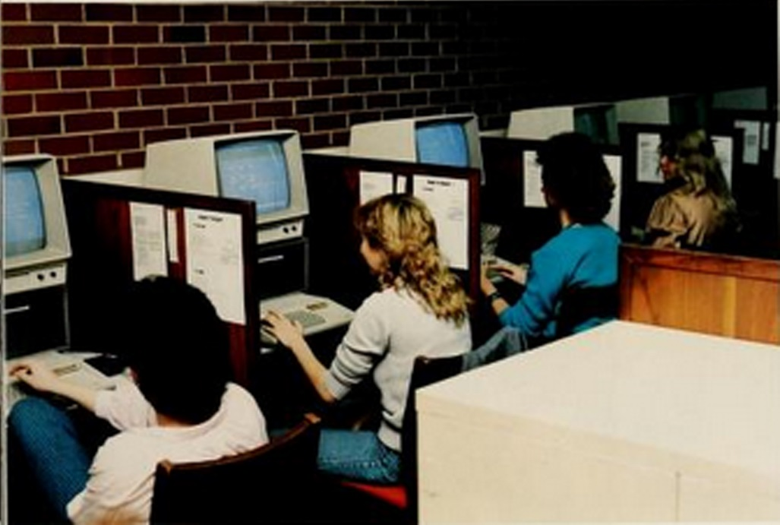
STEP FIVE: Digitization
Digital Heritage Center
Converting VHS and DVDs to digital files
Making sure your documents are searchable
Notes:
The last step, and in some ways the most exciting one when we’re talking about preparing an archival collection for useability, is digitization. I’m not going to talk much about the philosophy of digitization, though there’s quite a bit of discussion about equal access, privacy, and cultural concerns in the world of archives. Instead, I’m just going to talk about some useful tips to creating a digitized collection.
For your images and yearbooks, contact the North Carolina Digital Heritage Center. Information to contact them is on your handout. They are setting out to digitize and make available historical artefacts about the state of North Carolina. They’ve been a pleasure to work with so far, and in exchange for hosting your digital images on their website (which is a win for you, since it makes them easily available without putting a burden on your college servers), they will take over the huge task of digitizing your artefacts. The only real caveat is that you do have to create some pretty full descriptive files for them.
So what if you have AV materials that you want to make available? Digital NC doesn’t yet do that work for you. We’ve been working with a company in Apex to convert our multi media collection to digital files. They’re reasonably priced, and we’re happy to support local businesses. They’re called Home Video Studio and again, the contact information is in the handout.
The only note I’m going to give you about the actual process of digitization is that, if you’re scanning documents, make sure you’re creating OCR searchable documents. They will be infinitely more useable if you or your patrons can search the full text. We have a terrible scanner, and even it has the option of creating OCR searchable PDFs.

Slide 13
Making Your Archives Work for You:
Outreach and Marketing
Notes:
Ok, so we’ve talked more than I really wanted to about the nitty-gritty of working with archives. Hopefully no one ha fallen asleep! Now let’s get to the fun stuff—taking all that work you’re doing and seeing some immediate returns on your time investment!
Archives have incredible marketing power, particularly in today’s nostalgia fueled world. Look at the prevalence of activities like throwback Thursday on Facebook and twitter, or the fascination with using filters on Instagram. People’s exciteemtn about generally “old stuff” is the percfect thing for you to capitalize on to drum up some great buzz about your library. I’m going to share 4 activites we’ve done to use archival materials for marketing and outreach. This should get you started, but I’m hoping that everyone in this room comes up with at least one more great idea when they start working with their archives.

Slide 14
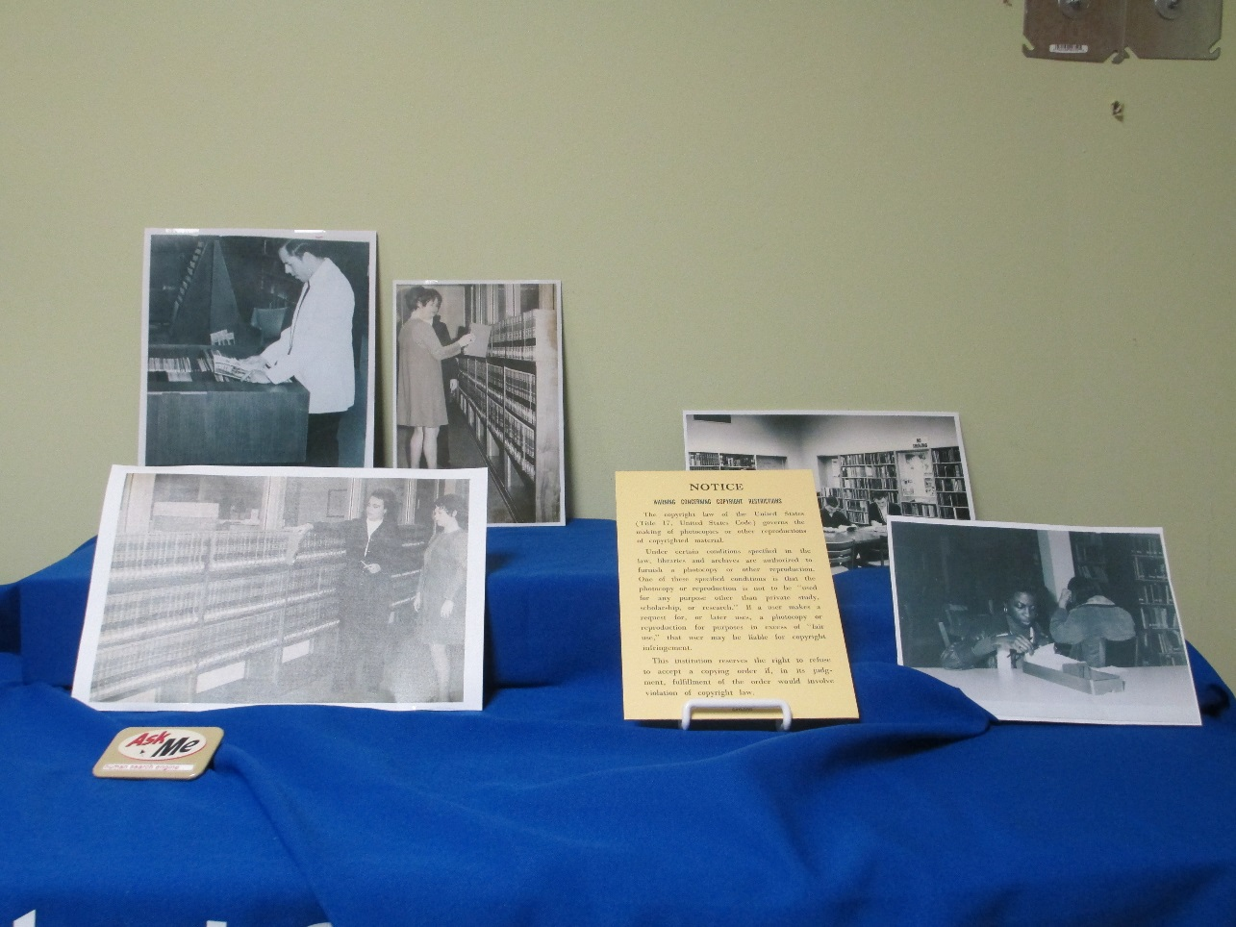
Displays
Work with your space
Themes
Be creative. Don’t just use photos.
Notes:
Let’s start with something simple but tried-and-true. Archive displays are always a fun feature in your library. That tie your library users to the idea that they are part of a community with deep roots, and if nothing else, they’re usually pretty fun to look at.
A couple of notes about creating winning archive displays.
Work with the space you have. I’m willing to bet that most of the libraries in our system don’t have the budget to go out and buy fancy glass display boxes. I know that’s probably about 15th on our supply wishlist. Which means we’ll probably get one in about ten years. So we’ve had to get creative to make our displays. What we’re doing right now is taking the top shelf of our periodicals shelving unit and filling it with our archival displays. This fills up an otherwise very empty space since Our print periodicals are not a huge collection, and it gives us a pretty nice, aesthetically pleasing display surface. Work with what you have.
Second, tie your archive displays to themes in the library. Each month, the cccc library spotlights a different campus program and advertises the different resources we offer for students in that program. Some of these have lent themselves really well to archival displays. When we spotlighted Allied Health, we did a display ont eh istory of the nursing program. People go t a big kick out of that one because there are some great old photos of nurses doing wacky things in our archives. Not to mention the old uniforms they had to wear with the bonnets and everything. People really enjoyed this dispay. Right now, I’m putting together a display to go along with our NLW activities about the early years of the library. Integrate your archival themes into the libraries other displays or activities. This ties the archives to the library, and gets people talking not just about the display, but about the library in general.
Finally, get creative. Don’t just go strauight to your photo collection. Look at the artefacts, and even the documents that you have. We have a bunch of old sports memorabilia. That would make a great display. Do you have old student ID cards? Technology? Student projects? This type of thing makes a display much more appealing.

Slide 15
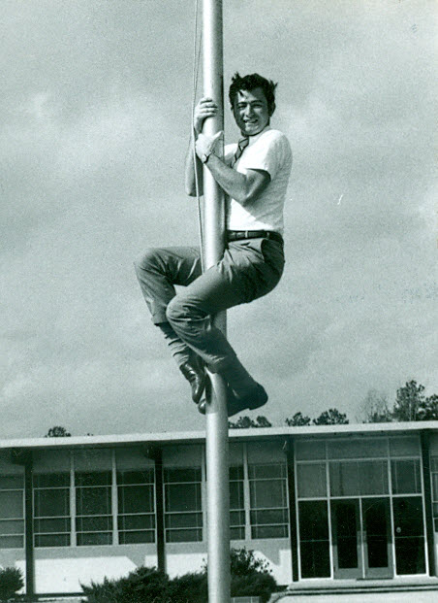
Facebook
Throwback Thursday
Identification
Notes:
So displays are still useful, but the time and effort it takes to put them together can be daunting. A much fast to way to get great returns is utilizing a service that you’re hopefully already using: facebook.
We started participating in Throwback Thursday last spring, and it’s been one of our biggest facebook triumphs. The picture here was posted inJune of last year. It reached 80 people, got 7 likes, and was even shared. STHis may not sound like much, but for a summer post on our facebook, reaching 80 people is a pretty big deal.
Another way we’ve utilized facebook is as an identification tool. A few times when Ive had a photo and I can’t identify the subject, but I know there’s something familiar about him or her, we’ve posted it to Facebook and most of the time we get the right identification back. People are excited to participate, it gets them in communication with us, and it helps me out on the descriptive front. Overall, a pretty good outcome for a very simple task.

Slide 16
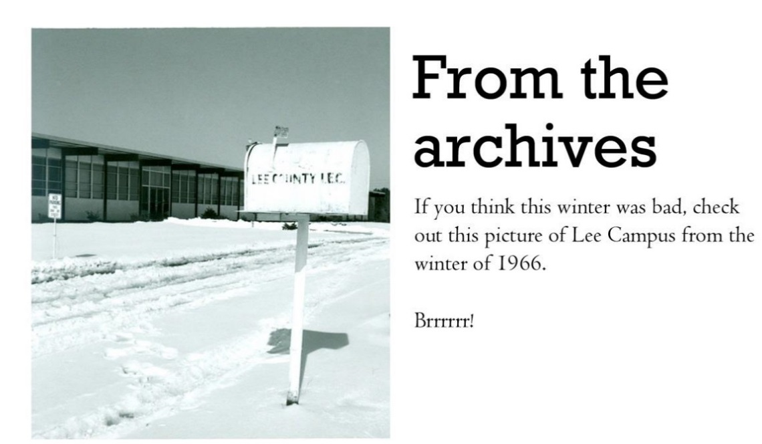
Newsletters/communication
Include an “Archives Corner” in your regular newsletters
Use photos from your Archives to illustrate library communications (where appropriate)
Notes:
Are there any library communications you currently use that could beillustrated with archival materials?
In our semester newsletter, I’ve started to include an “archives conrer” where I piost a fun picture from our archives and tie it to campus activities. For example, last spring I used this image with the caption “You though this winter was bad, check out this picture from Lee campus in 2966. Brrr!”
This is a hard one to measure the actual return on our time investment, but I figure it can’t hurt, and it makes us look more fun then just article after article about new book acquisitions.

Slide 17
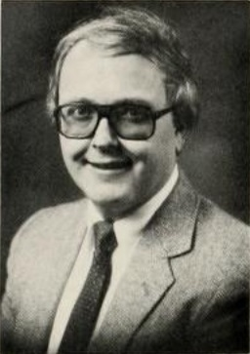
Faculty/Staff outreach
Provide photos for staff parties and professional development days—great conversation pieces!
Offer to find information, photos, & proof of embarrassing facial hair for retirement parties and award ceremonies
Talk to your marketing department about possible collaborations
Notes:
Finally, my favorite outreach activity was discovered by accident.
Last year, one of our faculty memebrs celebrated his 30th anniversary with the college and soeone contacted me looking for any old pictures of him. Actually, they contacted marketing, who said maybe try the library, where they were put in touch with me. Another good reason to make it clear that the archives are available through the library! I found this picture of him from his very first year on campus and sent it in. At the Christmas party this year, when they handed out the longevity awards, they put this up on the screen with the caption “Guess who?” For the rest of the party, people were asking where they got that picture. The word that the library rovided it, and has a lot more where that came from, spread around and by the end, we were the most buzzed about department on campus.
So offer to provide photos, documents, or artefacts to display at professional development days, staff parties and more.
Just after this experience, I did a similar project for a retirement party. They wanted anything I could give them, so I included all of these faculty newsletters from the 80s and 90s mentioning this instructor, and I even managed to dig up a copy of lyrics he wrote to a song about the SACS accedidation process. It was a big hit, and they created a really nice display spanning this instructor’s career at he college.
Finally, if you’re having trouble making inroads with any of these possible ideas, talk to your marketing department. Theymay have ideas about collaboration, or departments that might want these types of materials.

Slide 18
To sum it all up...
Notes:
Let’s go back to the mission statement we talked about earlier. In the CCCC mission statement, we highlight the importance of access. This isn’t just a buzzword, we really mean it. The heart of any of our library activities is providing a useful and valuable service to our community of students, faculty, and staff.
Everything we’ve talked about since has been in support of this idea. Whether you’re looking at the details of a descriptive file, or deciding on the best format for a finding aid, the first idea on your mind should always be “how will this impact my community.” When we talk about extracting immediate value from our archival collections, we’re really talking about showing off what we have, and more importantly, what it can do for our patrons. We get fantastic value from these activities in terms of positive word of mouth marketing for the library, but in the end, it’s all about getting our communities, weather students, faculty, or administration, to recognize our value too, and choose to invest their time with us, either as a user, or as a group capable of making decisions that impact our institutions.

Slide 19
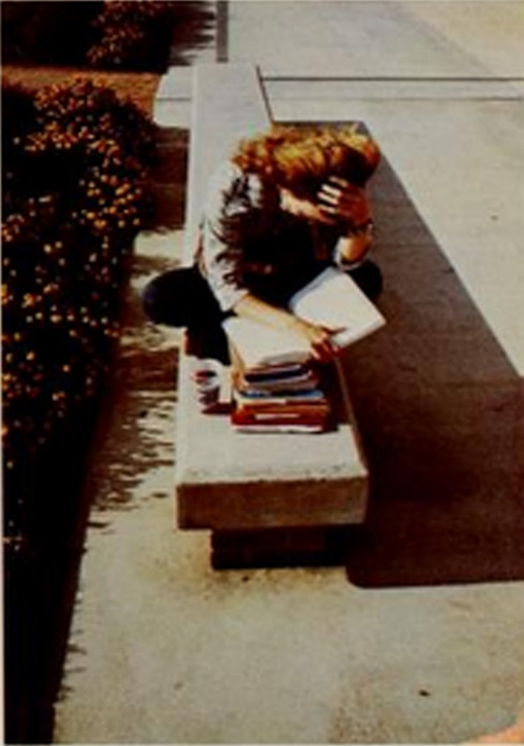
Tips & Tricks
Know what you have
Balance accessibility with preservation
Invest in quality preservation materials
NC Digital Heritage Center
Integrate archives into your existing outreach
Notes:
So, We’ve covered the five steps to creating a useable archives, and some ideas for how that archive can give you, the library, some immediate value. I just want to leave you with a few reminders and nuggests of pseudo-wisdom from my time working with archives.
One, figure out what you’re dealing with before you start arranging and escribing anything. It may seem like you’re spending a lot of time on prep work when you’re itching to get started on the real project, but I promise, the time spent taking stock of your archival holdings will make your life easier down the road.
Two, always remember to balance accessibility with preservation. Keep both of these in mind with every step of the process.
Invest in quality preservation materials. This may seem aughable if you barely have a useful book budget, but making sure your materials are preservation quality is really important, and will same more money in the long run.
Contact the NC Digital heritage center. It’s not just that they deal with the process of digitizing for you. They also create a higher quality digital image and include it in a wonderful, searchable database. This is what you want!
Finally, do what you can to integrate the archives into your existing outreach, or come up with new marketing ideas altogether that utilize your archival materials. This not only goes pretty far with your audience, but it really makes you feel like all the work you’re doing is immediately valuable. No matter how important you think preservation is, that has to feel good.

Slide 20
Resources
Hensen, S. (2004). Describing archives: A content standard. Chicago, Illinois: Society of American Archivists.
Millar, L. (2010). Archives: Principles and practices. New York: Neal-Schuman.
National Archives and Records Administration. (n.d.). Retrieved March 11, 2015, from http://www.archives.gov/
Roe, K. (2005). Arranging and Describing Archives and Manuscripts. Chicago, Illinois: Society of American Archivists.
Society of American Archivists. (n.d.). Retrieved March 11, 2015, from http://www2.archivists.org/
Notes:
Thank you for joining me. Here’s a list of resources I use a lot when working with archives. It’s also available in your handout.
I thik we have a few minutes for questions.

