Slide 1
Show Your Value & Relevance
Be An Aggressive Weeder

Slide 2
“Killing Sir Walter Scott”
Weeding a library collection, while an absolutely essential part of collection management, is a much more complex issue than library literature—and library practitioners—would like to admit. It is not just an intellectual and physical process but an emotional one, wedded to deep psychological, cultural, and even metaphysical issues. Weeding can be so heartbreaking, difficult, and miserable. --Laura Raphael

Slide 3
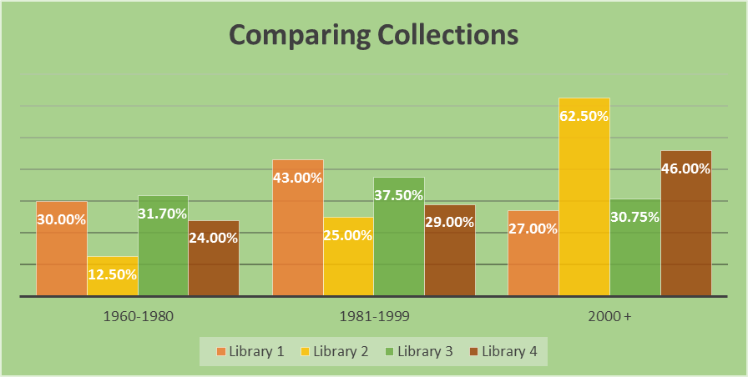

Slide 4
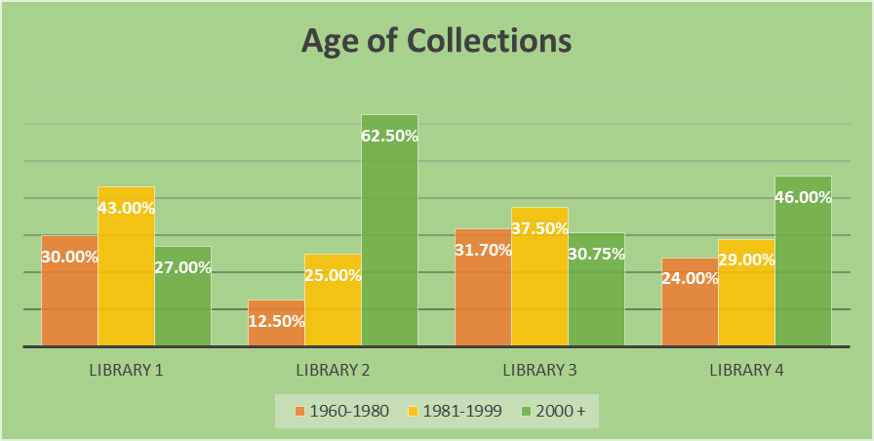

Slide 5
Reasons to Avoid Weeding the Collection
"Next to emptying the outdoor bookdrop on cold and snowy days, weeding is the most undesirable job in the library. It is also one of the most important. Collections that go unweeded tend to be cluttered, unattractive, and unreliable informational resources."
Will Manley, "The Manley Arts," Booklist, March 1, 1996, p. 1108.

Slide 6
More Reasons to Avoid Weeding
  No Time
  I don’t want to hassle with book disposal
  Library Shelves will be empty
  It is akin to Censorship
  There will be no books on ___ if I weed
  Others?

Slide 7

Yet another reason not to weed

Slide 8
Writing De-Selection
Procedures
What to Include
Overall Principles
Statement of Responsibility for De-Selection
Specific Considerations by Subject

Slide 9
CREW method
M= Misleading--factually inaccurate
U= Ugly--worn beyond mending or rebinding
S= Superceded--by a new edition of by a much better book on the subject
T= Trivial--of no discernible literary or scientific merit
I= Irrelevant to the needs and interests of the library's community
E= Elsewhere--the material is easily obtainable from another library

Slide 10
Setting Goals
Be realistic
Look for Achievable Milestones
  Literature—probably won’t be weeded every 5 years
  Current Fiction—probably should be weeded every 5 years
  Medical/Allied Health—every 5 years
Put Dates on Calendar
Target a Subject area

Slide 11
QUESTIONS/DISCUSSION
What are your top 3 goals for weeding your collection?
What is a realistic timeline to accomplish the 1st goal?

