Slide 1

Workplace
Information Literacy
NCCCLA 2015 Conference, Wake Tech
March 16, 2015

Slide 2

From the work of Mike and Nora, focusing on CC Librarianship
Mike Crumpton
  Assistant Dean for Administrative Services
  University Libraries
  macrumpt@uncg.edu
Nora Bird
  Assistant Professor,
  School of Education, DLIS
  njbird@uncg.edu
Code = Q11420
from ABC-CLIO

Slide 3
Unique Challenges of CC Libs
Working with diverse clients/patrons
Workforce and lifelong learning issues
Dealing with early and middle colleges
Small staffs and personal skills employed
Distance education programs
Management and administrative skills
Adult learning and andragogy skills
Resource specialization
Workplace information literacy and ID

Slide 4
General Community College curricular purposes:
Academic transfer preparation
Vocational-technical education
Developmental education
Continuing education
Community service

Slide 5
Information Literacy
According to many definitions, the information literate person “must be able to recognize when information is needed and have the ability to locate, evaluate, and use effectively the needed information.” (American Library Association, 1989)
Challenge is: Would you define Workplace Information Literacy differently?

Slide 6
Annemaree Lloyd’s Work
“Information literacy landscapes: Information literacy in education, workplace, and everyday contexts”
Her title says it all. Context is essential to the process. There is no universal information literacy.
The focus has been on academic information literacy.
Notes:
Very few “blue-collar” vocations have been studied – Crawford & Irving worked with nursing home staff, Lloyd worked with firefighters, but what about police officers, plumbers, auto mechanics, etc.

Slide 7
Focus Groups
Confirmed the impression that vocational programs are underserved
“I don’t know many people who have HVAC degrees... If HVAC approached me to do an [IL class] I’d have to get familiar enough to be able to answer subject-specific questions. That’s a mammoth job.”

Slide 8
Producing IL Equity
Re-investment of time into addressing issues of equity in information literacy teachings:
Emphasis on explicit instruction
Addressing economic, social and political factors
Early student engagement
New “conceptualizations” of reading
IL as practice
Insights from workplace information literacy

Slide 9
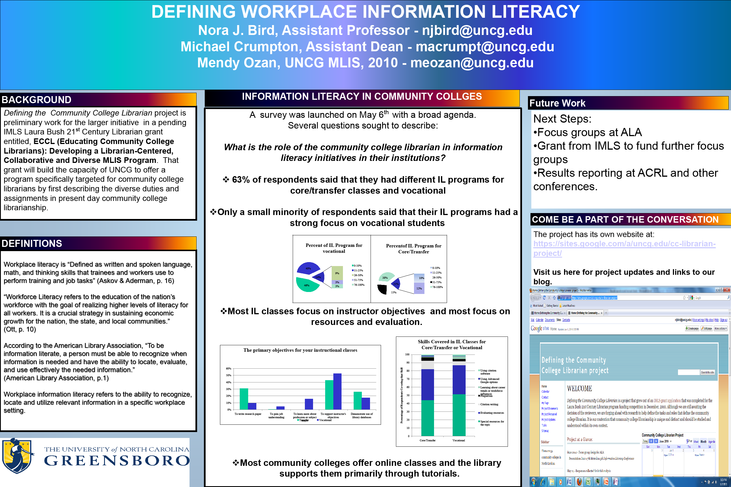

Slide 10
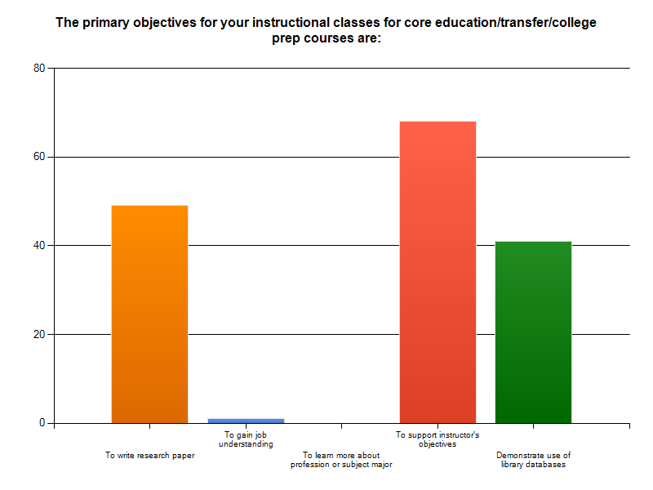
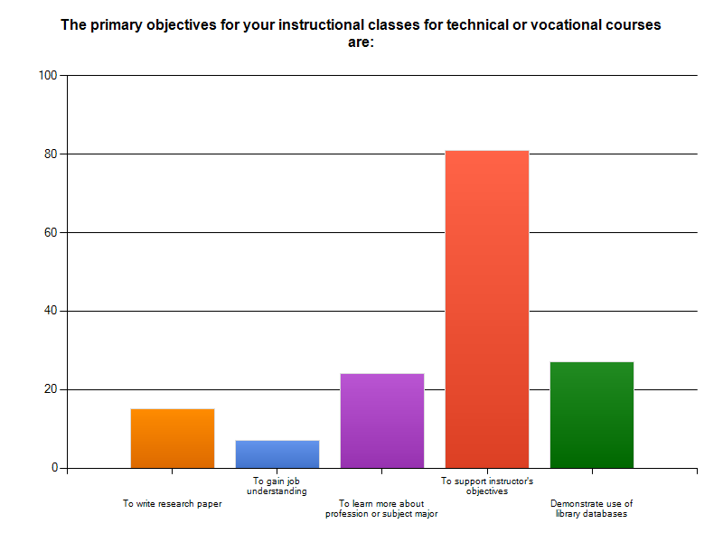
Instructor Objectives key!
Disparity with papers and jobs

Slide 11
Working with Instructors
Subject Matter Experts
Course specific needs
More resources, less academic structure
Request job related resources
Web evaluation skills important

Slide 12
Best Practices for LI in Workplace
Doing research
Sources and practices
Team approach to problem solving
Solving information problems
Staying on top of things after college
Learning as a product of practice
The role of people as knowledge resources
Community resources that are available
academic
Workplace needs

Slide 13
Related Workplace Research Skills
Engaging or collaborating with team members or department co-workers in research process
Retrieving information using a variety of different formats and sources
Making sense or patterns and data conclusions
Fully envisioning problem or topic with scenario placement for “what if’s”

Slide 14
Workplace Information
Competencies Needed
Graduates should know how to evaluate sources and determine credibility
They should be able to critically read and analyze published sources for data relevant to solving the problem
They should be able to synthesize large volumes of content in order to reach appropriate conclusions

Slide 15
McGill’s Continuing Education
Addresses information literacy for continuing education curriculum
Addresses diverse learning objectives and needs of CE students
  Andragogy
  Culture and language
  Active environments
Instructor awareness
  Of options available
  Of need for including IL within coursework

Slide 16
JMU - Employer Expectations
Research study
  Types of information in the workplace
  Information tools used in the workplace
  Activities performed by research and information
  Research skills needs
  How do graduating students measure up?
Results recommend a more varied approach to information literacy instruction

Slide 17
Crawford and Irving’s Human Element
Key role of human relations in the workplace to foster information literacy
Proactive consultation with agencies involved in skill development and training
Provide internally benchmarks, resources and space dedicated to fostering IL growth

Slide 18
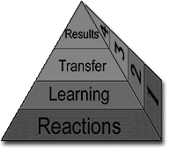
Kirkpatrick’s 4 Levels of
Training Evaluation
The four levels of Kirkpatrick's evaluation model essentially measure:
REACTIONS-What they thought and felt about the training
LEARNING-The resulting increase in knowledge or capability
TRANSFER-Extent of behavior and capability improvement and implementation/application
RESULTS-The effects on the business or environment resulting from the trainee's performance

Slide 19
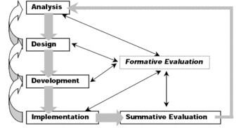
ADDIE Model
The ADDIE instructional design model is the generic process traditionally used by instructional designers and training developers. The five phases—Analysis, Design, Development, Implementation, and Evaluation—represent a dynamic, flexible guideline for building effective training and performance support tools.

Slide 20

Real Learning Connections Project
Current Theory
and Research
LIBRARIAN
Practical Work Experience
FACULTY
STUDENT
Academic Content

Slide 21
Training vs. Education
Practice
Taking action
Focus on performance
Knowledge content
Educating first
Theory
Cultivate minds
Knowledge
Change to known's
Training for something
Training
Education

Slide 22
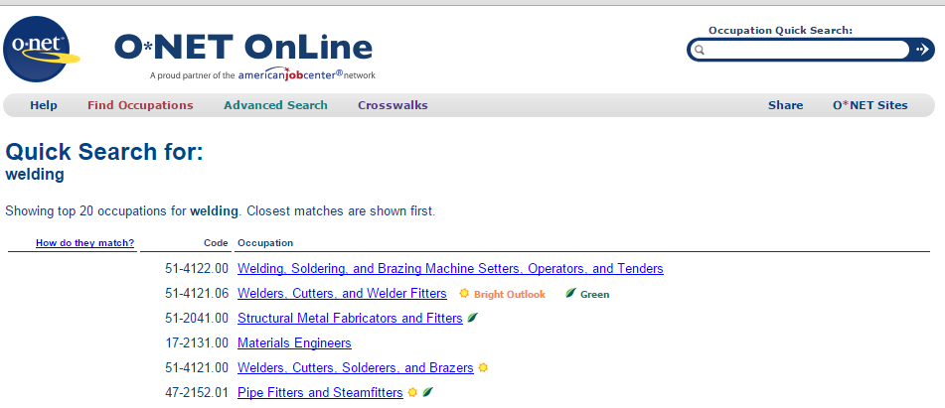
O*Net

Slide 23
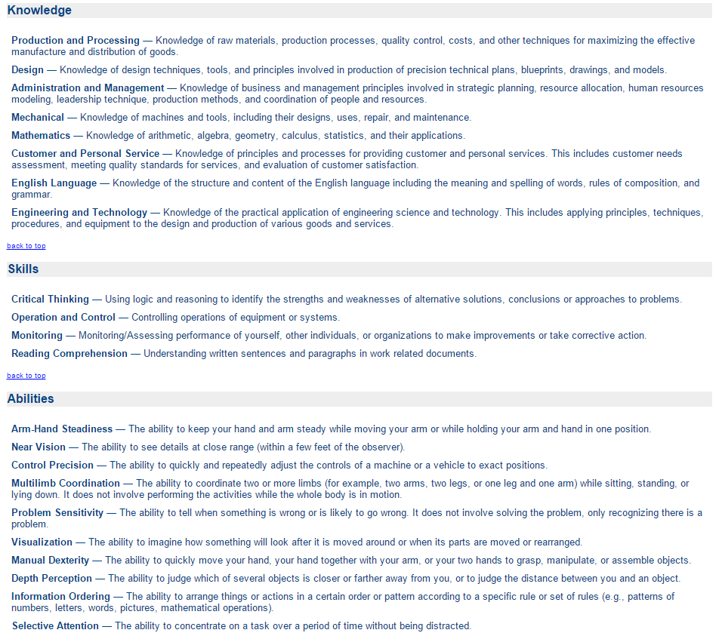
Welder KSA’s

Slide 24
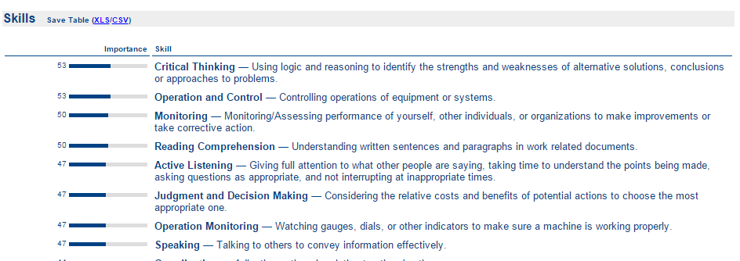
How important?

Slide 25
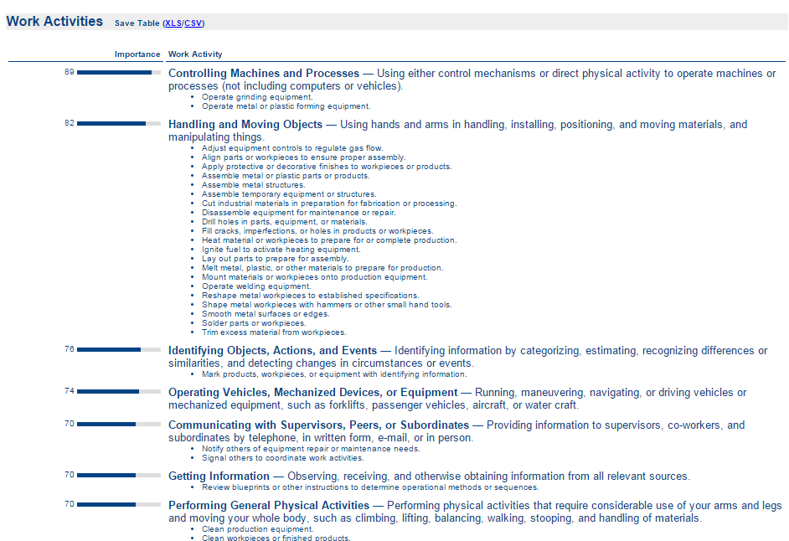
Activities

Slide 26
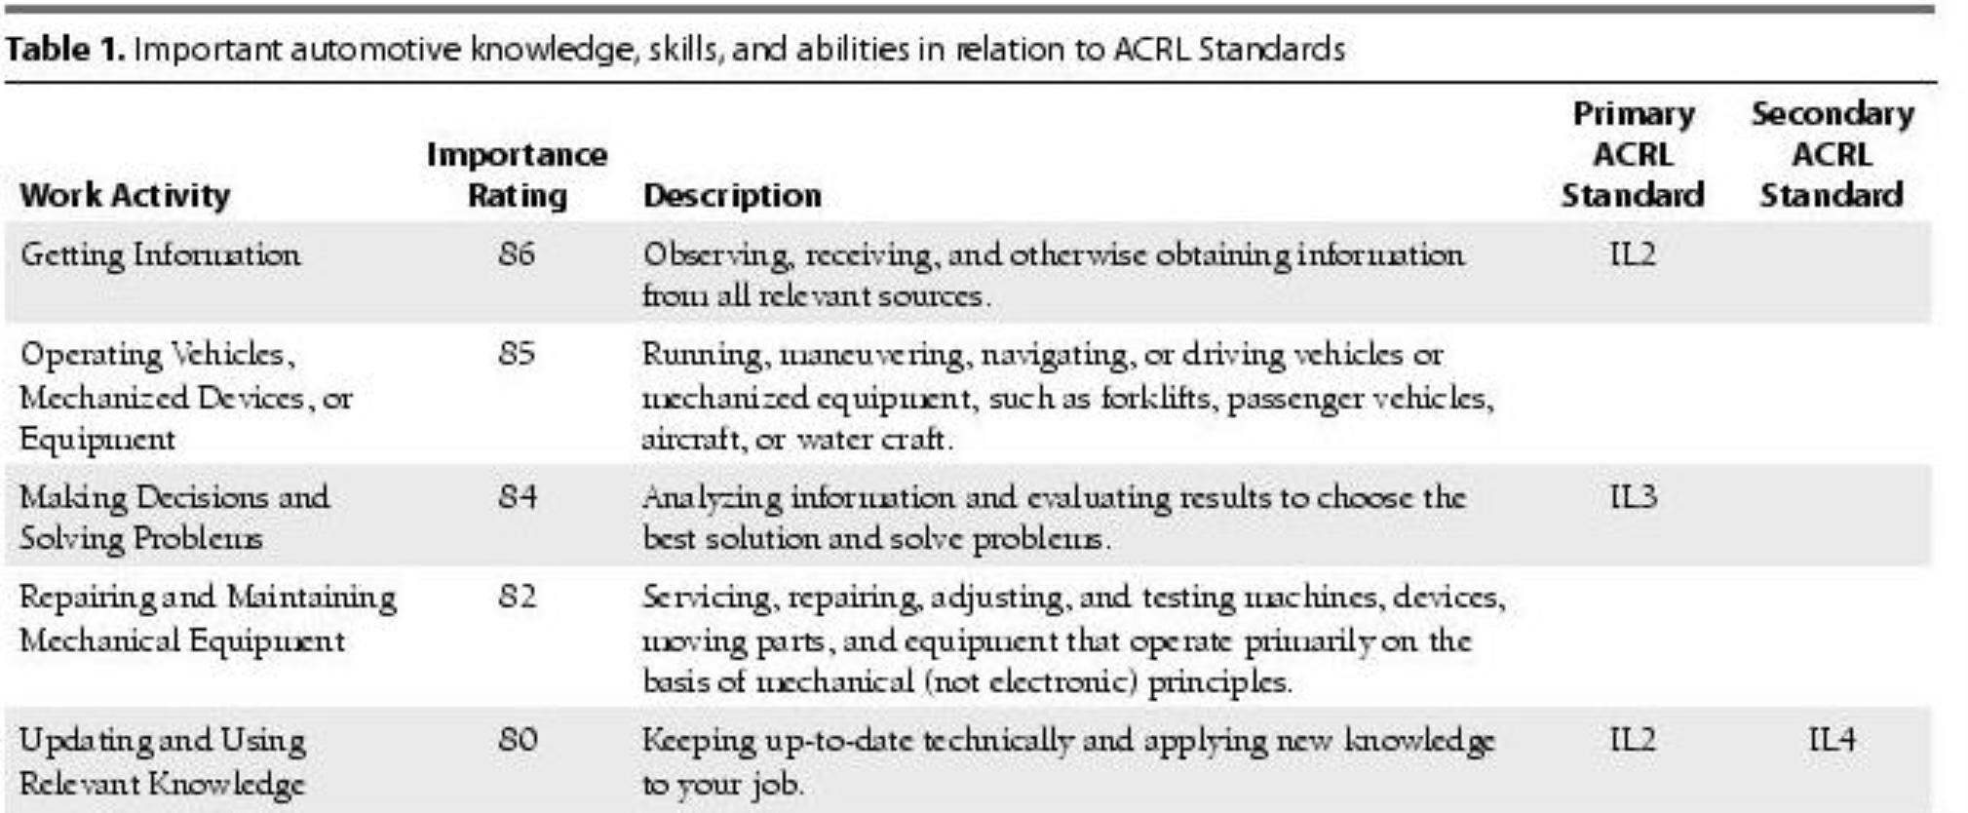
Links to old ACRL standards

Slide 27
Project Information Literacy
Difficulty to solve problems
Lack of sense of urgency
Needed to reach out to colleagues
Online searching skills
Traditional research competencies
Interpreting results
Work with team
Students
Employers

Slide 28
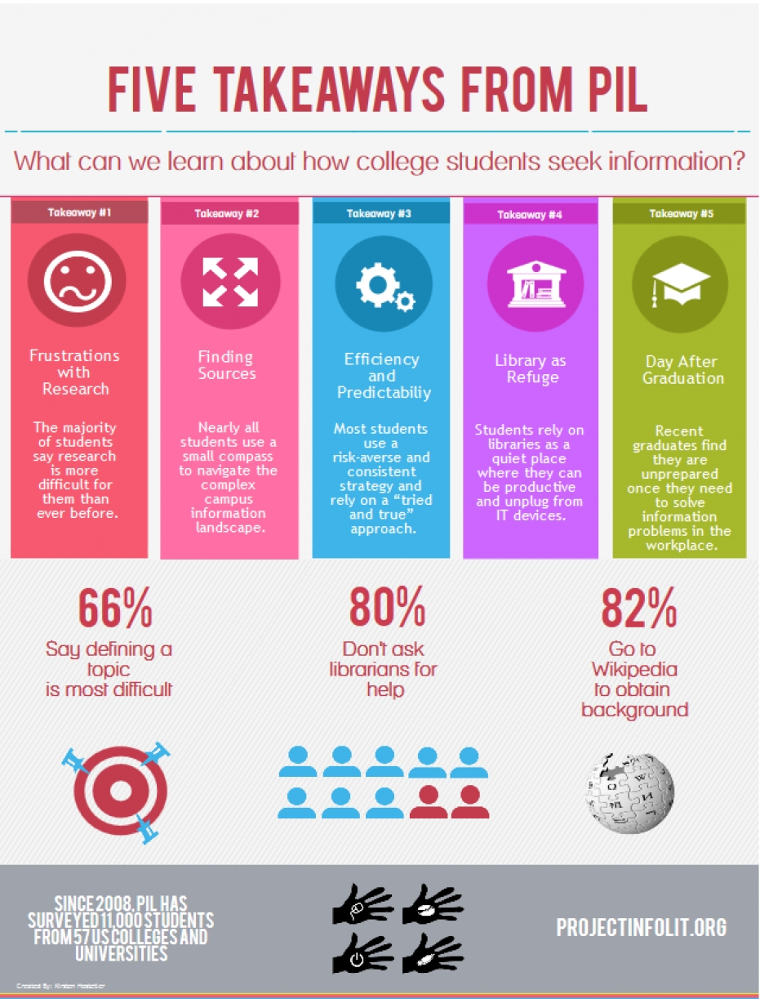

Slide 29
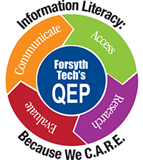
Preparing Students
What Employers said:
  Communication skills
  Social/networking skills
  Problem solving
  Computer is not workspace
Forsyth’s QEP
Workplace Perspective

Slide 30
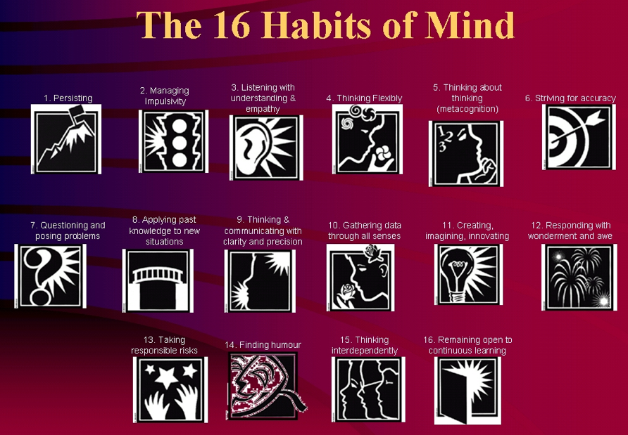

Slide 31
In Summary
Community colleges and their libraries serve a broad range of needs, including vocational/technical programs needing different information skills
Need for workplace literacy instruction strong
Advocacy needed for support of this unique environment
Uniqueness translates into broader range of skill sets for librarians
Workforce changes still trending high, challenges for librarians will increase

Slide 32
Trusting Google
http://languagelog.ldc.upenn.edu/nll/?p=1701
http://uncg.worldcat.org/title/an-assessment-of-google-books-metadata/oclc/4839658031

Slide 33
Where do We Go From Here
Project Information Literacy
Talking to employers
Curriculum mapping
Expansion of resources
Feedback from you!

Slide 34

Workplace Information Literacy Instruction Project
Harper Campus

Slide 35
Project Overview
NCLA Leadership Institute Project
Initial planning phase
Pilot Programs
  Advertising and Graphic Design
  Air Conditioning, Heating & Refrigeration

Slide 36
Why
CPCC Harper Campus Programs
Collaborative relationship exists with program faculty
Libraries are seldom seen as a resource in trade/career type programs
Students need workplace information and digital literacy skills
Opportunity to correlate library services to student success and employability

Slide 37
Timeline
Spring 2015
  Draft Curriculum Map for A+GD and AHR
  Pilot Class (AHR110) – March 19
  Collaborate with instructors to develop assignments and learning outcomes
Summer 2015
Continue research and literature review
Finalize curriculum map
Develop learning outcomes and lesson plans
Work with Workplace Learning Department
Fall 2015
  Formal start of 2 year pilot.

Slide 38
References and Readings
Bird, Nora J., Michael A. Crumpton, Melynda Ozan, and Tim Williams. "Workplace Information Literacy: a Neglected Priority." Journal of Business & Finance Librarianship 17.1 (2012): 18-33.
Head, Alison J. and Eisenberg, Michael B., First Monday, April 2011, "How College Students Use the Web to Conduct Everyday Life Research," vol. 16, no. 4 (23 pages).
Head, A.J., Van Hoeck, M., Eschler, J. and Fullerton, S. (2013). “What Information Competencies matter in today’s workplace?, Library and Information Research 37.114
Karp, R. (2006). Leadership issues for community college librarians. In D. Dowell (Ed.) It’s all about student learning: Managing community and other college libraries in the 21st century. Westport, CT: Libraries Unlimited.
Lloyd, A. (2010). Information literacy landscapes: Information literacy in education, workplace, and everyday contexts. Oxford, UK: Chandos Publishing.
Lloyd, A. and Williamson, K. (2008). Towards an understanding of information literacy in context: Implications for research. Journal of Librarianship and Information Science, 40(1), 3-12.
O'Hanlon, Nancy. "Information Literacy in the University Curriculum: Challenges for Outcomes Assessment." Libraries and the Academy 7.2 (2007): 169-189. Web. 2 Feb. 2012.
Patterson, David. "Information Literacy and Community Colleges Students: Using New Approaches to Literacy Theory to Produce Equity." Library Quarterly 79.3 (2009): 343-361.
Trott, Barry, Nora J. Bird, and Ted Williams. "Casting a Wider Net: O*net, Workforce Development, and Information Literacy.(information Literacy and Instruction)(column)(website Overview)." Reference & User Services Quarterly. 53.3 (2014).
Warren, Leslie A. "Information Literacy in Community Colleges." Reference & User Services Quarterly 45.4 (2006): 297-303.

