Slide 1

Advocacy Committee

Slide 2
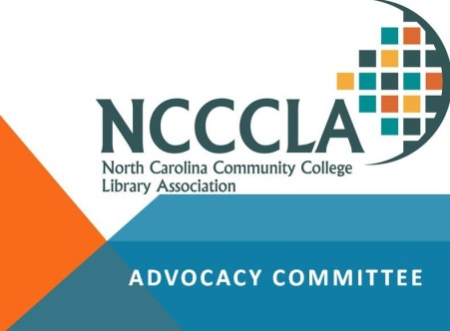
2018-2020 Committee
NCACCP Presidential Liaison –
Dr. Stanley J. Elliott, Roanoke-Chowan
Chair – Libby Stone, Gaston College
District 1 – Mary Ann Caudle, Martin CC
District 2 – Cathy Campbell, Craven CC
District 3 – Debbie Luck, Randolph CC
District 4 – Carl Danis, Sandhills CC
District 5 – Charles Wiggins, Isothermal CC
District 6 – Russell Taylor, Asheville-Buncombe TCC
NCCCS Representative –
Helen Colevins, Community Engagement Librarian

Slide 3







Partners in Education
North Carolina Community College Libraries Are
helping students meet their goals for long-term success
Enriching the
Student Experience
Supporting
Faculty Excellence
Providing
Expertise & Resources
81%
7 out of 10 faculty reported getting research help at the library and…
70%
of students surveyed said staff helped them complete coursework.
of students surveyed said the library contributed to their overall academic success.
nearly 9 out of 10 faculty surveyed said they used the library website to find resources.
Community college libraries provided access to over
30 million
resources last year plus technology and Wi-Fi.
Funding for databases & staffing is critical
NC Community College Libraries have not received an increase in their collections budget since 2009 while the average price of a database subscription has increased 40%
Database Price Increase
65% of surveyed libraries reported the same or fewer staff as in 2008
while providing services
in more
locations.
Quotes
quotes
quotes
Quotes
quotes
Quotes
quotes
English isn’t my first language, I had to learn it the hard way because I didn’t have much time. And the librarians were there for me every time I needed them. They treated me as a friend. They never gave up on me, and I am thankful for that; they helped me get on the right path in becoming a surgeon.
I come from a lower income family, so I don’t usually have all the necessary resources in my personal life to complete all of my classwork. The library at my school has provided so many resources that have helped me get all of my work done and I am very grateful for that….
I had been out of school for 33 years. I was not sure how to acquire information for the many essays required for my English class… I started having anxiety attacks, and almost quit . . .The librarian sat down with me and spent an hour explaining to me how to find what I needed, and how to cite my work . . . I couldn’t have done it without him, and may not be in college today if it weren’t for him and his knowledge of the library.
Data included in this report comes from Community College Libraries & Librarians and Student Success (2017), a survey conducted by the North Carolina Community College Library Association Advocacy subcommittee, and the North Carolina Community Colleges System Office.

Slide 4
Advocacy Best Practices with Dr. Anthony Chow
  Associate Professor, UNCG LIS Department
  ALA, Committee on Library Advocacy (COLA)
  Co-Chair, NCLA Advocacy and Legislative Committee
  State and National Consultant, strategic planning and evaluation
Take micro poll

Slide 5
What I’ve Learned
Know thyself – it is personal
Identify and align to high priorities of your institutions
Patron data and stories are golden – let them speak (they are your best advocates)
Seeing is worth more than a 1,000 words
Education and relationships are key – leaders and legislators are human too ☺!

Slide 6
Panel Discussion
Four panel and audience questions:
To what extent do you feel community college libraries are supported by college administration?
What are the highest priority issues facing CC libraries?
Do you feel confident that faculty, staff, administration, and state legislators understand the value of CC libraries?
If you were asked, what is your elevator pitch for the value of CC libraries and the need for additional funding?

Slide 7
Future Plans
Advocate on our campuses
Present at a meeting with North Carolina Association of Community College Presidents (NCACCP)
Continue to collaborate with NCLA and NCSLMA

Slide 8
Questions?

